Slide 1
Shree M.& N. Virani Science College(Autonomous) Affiliated to Saurashtra University,Rajkot
Department of Industrial Chemistry
ITPR/Seminar Presentation
(Innovexia Pharma)
Prepared By:
Kirtan K. Vaghani
19BIC050
Semester--V

Slide 2
Basic Information
Director:
Company CEO: Mr.Sandeep Khajuria
Year of Establishment: 2011
Legal Status of Firm: Limited Company (Ltd./Pvt.Ltd.)
Nature of Business: Manufacturer
Key Customers:
Star Pharmaceuticals
J. P. Pharma
ARN Purna Agency
Registered Address: SCF - 495, 2nd Floor, Motor Market, Mani Majra, Chandigarh- 160017, Chandigarh, India
Annual Turnover: 2012-13 Upto Rs. 50 Lakh
ROHIT SHARMA
REECHA SHARMA

Slide 3
Pharma Company - Innovexia
Innovexia Life Sciences Pvt Ltd is a profound name in the pharmaceutical sector. The company is best known for PCD Pharma Franchise business with the minimum investment. We are involved in the manufacturing, supplying, trading and marketing of high quality pharmaceutical products all over the country.
Being company have good reach and networking with the health professionals and hospitals.
We are manufacturing and trader a wide assortment of Pharmaceutical Capsules, Anti Allergic Tablets, Pharmaceutical Tablets, Antacid Medicines, Pharmaceutical Syrup, Herbal Medicines and Protein Powder or many more.
We are ISO 9001:2008, WHO and GMP certified and deliver the exceptionally high quality range of drugs at the affordable prices. Our state-of-art manufacturing facilities and fully integrated infrastructure allow us to provide our associates and customers with international standard quality products. The company is backed up by the team of best experts and experienced staff who are deducted towards the common motive of improving quality of life though innovation.

Slide 4
What Makes Innovexia the Top Pharma Company?
Innovexia Life Sciences has made its significant presence in the pharmaceutical industry by meeting the expectation of health professionals, patients and its business partners.
These are the things which makes us best for the PCD Pharma
Business:
Unique Monopoly Rights
Advance Therapeutic range
Promotional support
On time delivery of products
Ethical approach and mutual benefits for Pharma PCD Franchise Business.
Quality Assurance

Slide 5
Scope of Pharma Franchise Business in India
With the increasing population, changing lifestyle and development in the healthcare sector, the demand for high quality medicines has increased all over the country. In the coming years it is expected to grow more due to this the PCD Pharma Franchise business which is considered as the backbone of pharmaceutical company is seeing the huge success in the country.
People today wants to get the best quality, effective medicine at the affordable prices and through PCD and franchise it is easy to provide them the access for high quality products in their region. Apart from this, the government is also encouraging the pharmaceutical sector to meet the increasing demand for medicines in the country.

Slide 6
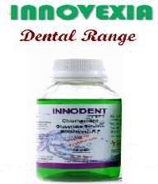
Innovexia Pharma Product
Dental Products
Herbal Products
Injections

Slide 7
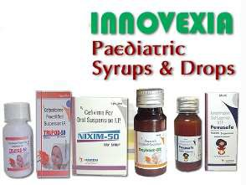
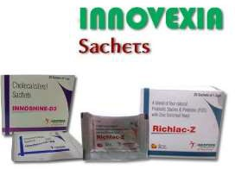
Innovexia Pharma Product
Paediatric Syrups & Drops
Powder Products
Sachets

Slide 8
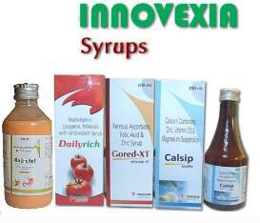
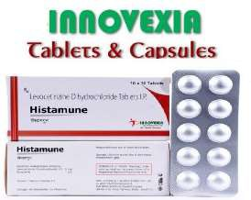
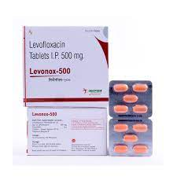
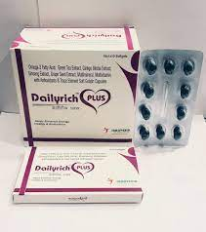
Innovexia Pharma Product
Syrups
Urological Products
Tablets & Capsules

Slide 9
Quality Assurance at Innovexia Life Sciences
Quality is our priority. We at Innovexia Life Sciences believes that the quality is the responsibility of everyone in the company. Innovexia Life Sciences have highly professional quality assurance team who are best in their work. This team monitor the manufacturing of products at every stage. We deliver exceptionally high quality range of drugs manufacturing by using best quality and hygienic raw material.
Our infrastructure, testing laboratory and advance technology helps us to produce high quality range of drugs at the most affordable prices. Start your business successfully with us and get the best quality range of drugs from our end.

Slide 10
Advantages of Associating with Innovexia Life Science
The company provides good incentives to its associates on meeting the annual targets.
We have spacious and germ free storage unit where all the products after manufacturing are stored.
Innovexia Life Sciences provide the huge product range with the best quality packaging.
The company regularly introduce new and innovative range of drugs to meet the market requirements.
The entire manufacturing takes place in GMP and WHO certified plants
The promotional kit that will include Sample, ASM bags, Pads Visual Aids, LBL, Reminder cards, Visiting card, Order books, MR bags, Gift articles for making your presence remarkable in the market.
We keep our associates well aware of the latest launch and development in the Company with the help of newsletter.
All the delivery is made within the 24 hours of placing orders.

