Slide 1
SHREE M. & N. VIRANI SCIENCE COLLEGE Faculty of Science DEPARTMENT OF INDUSTRIAL CHEMISTRY
ITPR/SEMINAR PRESENTATION
GANESH REMEDIES PHARMACEUTICAL LTD.
Prepared by:
Tadhani Akshay M.
19BIC042
SEM:-5

Slide 2
OUTLINE
Company profile
Introduction
History
Manufacturing
Research & development
Products

Slide 3
COMPANY PROFILE
Industry Founded:
April 27 1995
Headquarter:
Ankleshwar, Gujarat
Key people:
Mr. Chandu Kothia (Chairman)
Product:
Active pharmaceutical ingredients (APIs), Amiodarone, Cabozantinib, Olaparib, Amitriptyline, Gliclazide, Ketoconazole etc.

Slide 4
INTRODUCTION
Shree ganesh remedies limiteds core activitye chieflu consist of manufacturing & export of pharmaceutical intermediates & fine chemicals and research & development.
With a focus on quality,innovation and flexibility, we offer pharmaceutical custom manufacturing across the global network.
Company currently exports it’s products to over 30 countrys across the globe.

Slide 5
HISTORY
Shree Ganesh Remedies Limited was originally incorporated as a private limited company with the name ‘Shree Ganesh Remedies Private Limited’ at Ahmedabad Gujarat on April 27 1995.
Subsequently the Company was converted into a Public Limited company and the name of the Company was changed to ‘Shree Ganesh Remedies Limited’ on July 28 2017.
Shree Ganesh Remedies is a ISO 9001:2015 ISO 14001:2015 BS and OHSAS 18001:2007 certified Company and is engaged in manufacturing and dispatch of drug intermediates and chemicals like amine hydrochloride and specialty fine chemicals for pharmaceutical industry.

Slide 6
MANUFACTURING
SGRL has top talents for chemical reaction. The team works under the directions of doctorates in chemistry and pharmacy.
Our technical team includes engineers, science graduates and pharmacist for plant operation, production management and process development.
Our chemical expertise covers the varietys of reactions like Halogen, bromination, chlorination, hydrogejation & other high pressure use reactions like Friedel craft reactions, schiff base reactions, grignards reaction, esterification, cryogenic reactions, and ultra low vacuum reactions.

Slide 7
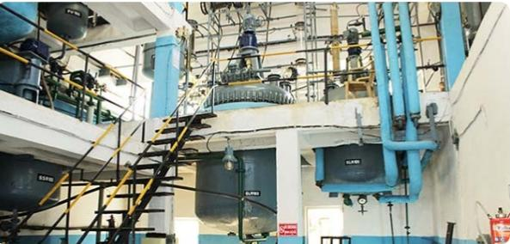
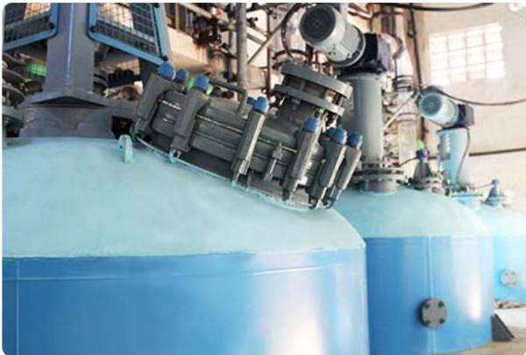
MANUFACTURING UNITS

Slide 8
RESEARCH & DEVELOPMENT
SGRL research Center is to work on new products and innovative technology for our customers in an inspiring environment.
Our R & D team at SGRL focuses on route evaluation and development, optimization of reaction condition, quality by process design.
Our research team is currently focused on developing patentabal non-onfringing processes for the company’s operations in the regulated marketes.
Our laboratory has latest and leading edge research facilities with high performance instruments.

Slide 9
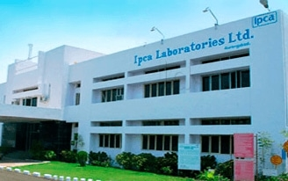
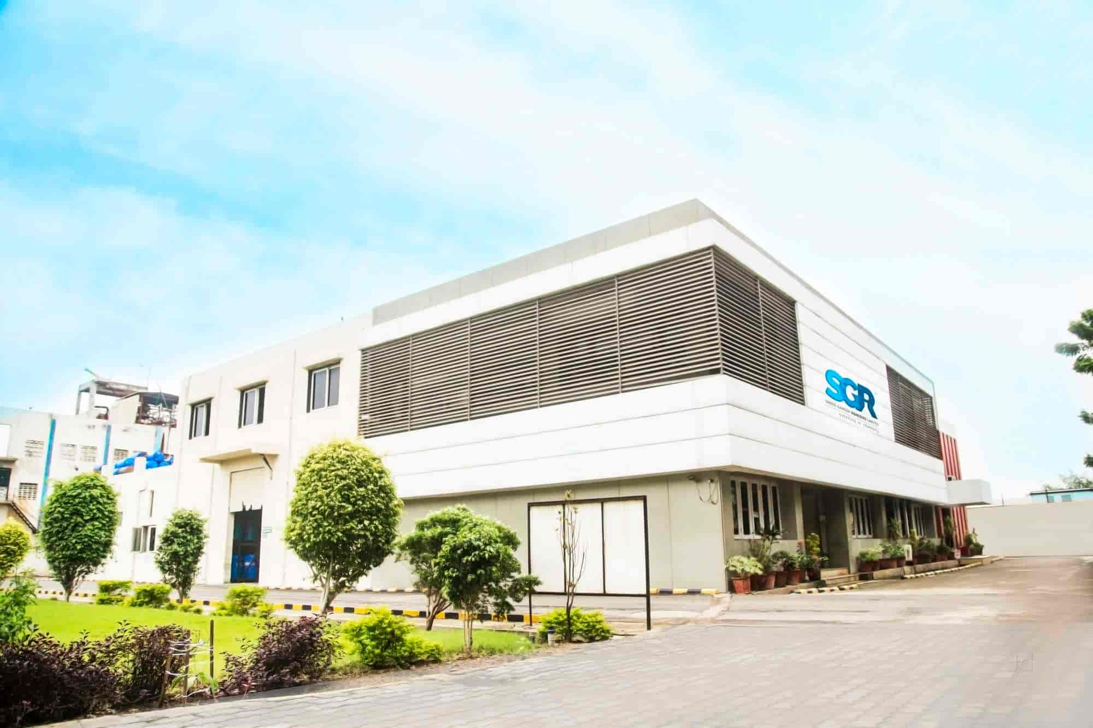
RESEARCH & DEVELOPMENT UNIT

Slide 10
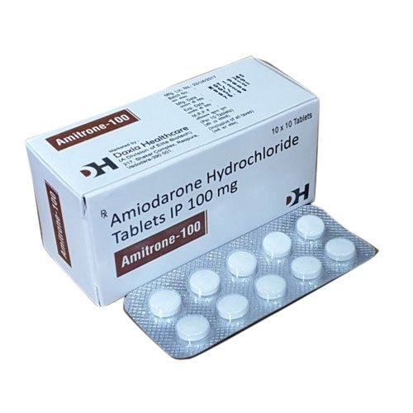
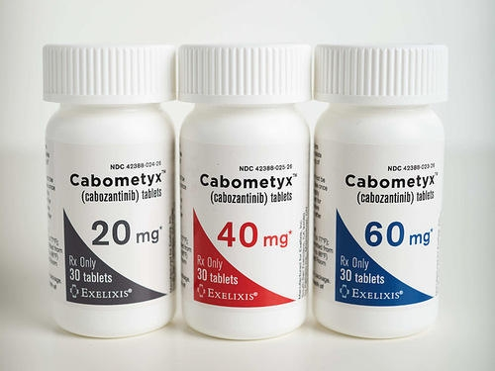
PRODUCTS
AMIODARONE:-
USE :- This medication is used to treat certain types of serious irregular heartbeat. It is used to restore normal heart rhythm and maintain a regular, steady heartbeat.
CARBOZANITINIB:-
USE :-For the treatment of metastatic medullary thyroid cancer (MTC). For the treatment of advanced renal cell carcinoma.

Slide 11
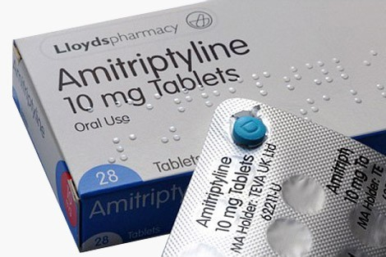
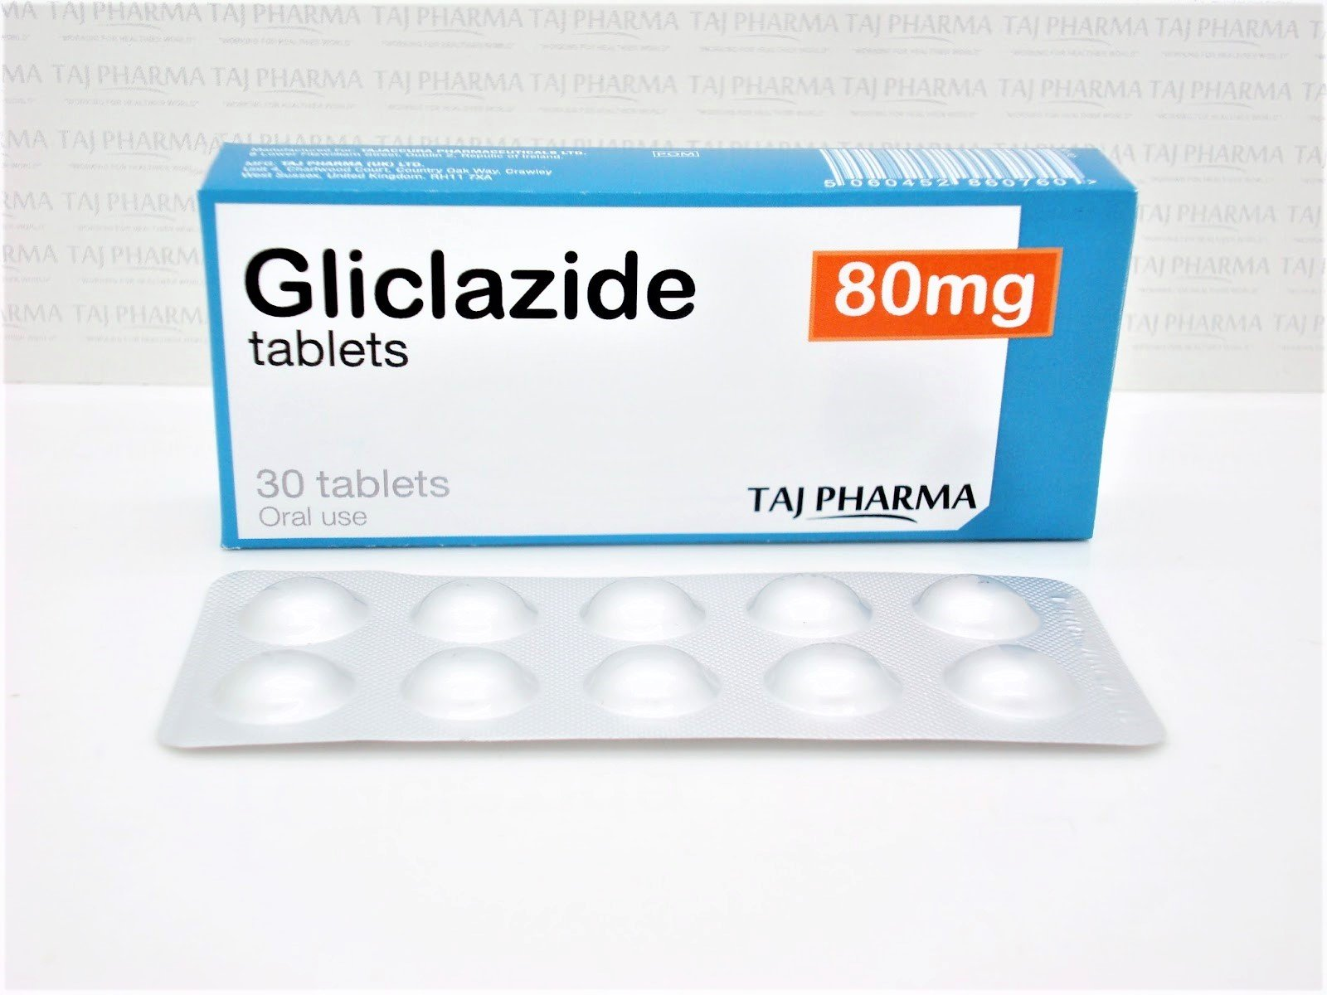
PRODUCT
AMITRIPTYLINE:-
USE:-This medication is used to treat mental/mood problems such as depression. It may help improve mood and feelings of well-being, help you sleep better.
GLICLAZIDE:-
USE:-Gliclazide is a medicine used to treat type 2 diabetes.

Slide 12
