Slide 1
WEL-COME

Slide 2
Shree M. & N. Virani Science College (Autonomous) An Affiliated to Saurashtra University Department of Industrial Chemistry
ITPR / Seminar Presentation
Arlak Biotech Pvt. Ltd.
Presented by :
Nikunj A. Vora
19BIC051
Department of industrial chemistry
Semester - v

Slide 3
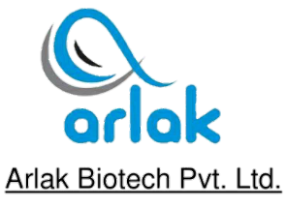
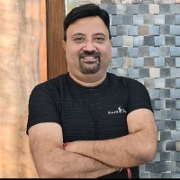
Founder :
Umesh Kalra
Established :
27 April 2007
Headquarter :
Zirakpur, Panjab - 140603

Slide 4
Vision
Working closely with the medical profession, the Arlak biotech contributes to the health of individuals and to the progress of medicine by adhering to our mission of creating superior pharmaceutical products and offering top-quality services.

Slide 5
MISSION
As members of the ARLAK BIOTECH, we will carry out our purpose to realize ARLAK’S mission and contribute to society by consciously putting into practice the following beliefs and principles.

Slide 6
HISTORY
Directors of Arlak Biotech Private Limited are Umesh Kalra, Dhiraj Kalra and Jyoti.
Arlak Biotech Private Limited is a Private incorporated on 27 April 2007.
It is classified as Non-govt. company and is registered at Registrar of Companies, Chandigarh.
Its authorized share capital is Rs. 300,000 and its paid up capital is Rs. 300,000.
It is involved in Manufacture of other chemical products.

Slide 7
Welcome to Arlak Biotech
Best PCD Pharma Franchise Company in India
Arlak Biotech is one of the top leading PCD Pharma Franchise Companies in Punjab India.
We are giving an extensive variety of PCD Pharmaceutical products to healthcare industry at most affordable cost.
Arlak biotech is marketing more than 1000+ brands for different human medical requirements.
Our portfolio incorporate Tablets, Soft gel Cap, Capsules, Injectables, Syrups, Topical gels, Creams, Oils, Lotions, Drops, Sachet and many more others as per medical requirements.

Slide 8
Arlak Biotech Pvt Ltd is a WHO-GMP Certified PCD Pharma Marketing Company.
We have a Fast distribution network that guarantees convenient access to our pharmaceutical formulations (Pharma products) throughout the country.
We also come in the list to top pharma franchise Companies .
We are providing highly innovative and understandable information to our customers through advertising data instruments.

Slide 9
THE COMPANY HAS THE FOLLOWING
BUSINESS DIVISIONS:
ARLAK GROUP Offering more than 1000 products covering all formulations (Tablets ,Capsules, soft gelatin capsule, syrups, Injectable, Soap, lotion, Powder, Sachets, Pre-filled Syringes etc.) and covering all area (medicine, gynecology, dermatology, cardiology, gynecology, diabetic, ophthalmic, ayurvedic etc.)

Slide 10
ARLAK BIOTECH PVT. LTD.
The parent company having more than 300 products & drawing its strength from years of proximity with doctors of various specialties across the country across that include Physician, Surgeons, Orthopedics, ENT, Gynecologists, Pediatricians, Chest Specialists, Gastroenterologists, Ophthalmologists, Neurologists, Psychiatrists & General Practitioners.

Slide 11
SOIGNER PHARMA
More than 250 products including antibiotics, analgesics, antacids, antivirals, anti-inflammatory agents, antifungals, beta-blockers, corticosteroids, hormonal preparations &nutraceuticals, caters to multi-specialties professionals like Consulting Physicians, General Physicians, Gynecologists, Neurologists, Pediatricians, Surgeons, Orthopedics, Dentists and ENT Specialists.

Slide 12
MORUF LIFE SCIENCES
A division dedicated to beautiful creature of God- The Woman; a special area of focus for us is issues related to women's health and healthcare. The division "Moruf Life Sciences" is catering to the products used for women including nutritional supplements, hormonal preparations, & other drugs used in Obstetrics & Gynaecology. It is committed to nurturing woman health through dedicated customer & patient centric services.

Slide 13
CORAZON
A division relating to cardio-diabetics products.
The ultimate aim of this SBU is to fulfil the rapidly increasing demand for drugs for heart disease & diabetes and our commitment is to provide patients a wide range of new medical solution with a high level of safety and efficacy.
Corazon offers comprehensive product basket on emerging disease areas like Congestive Heart Failure, Hypertension, Dyslipidaemias, Metabolic Syndrome and Arrhythmias.

Slide 14
ARLAK AYURVEDA
A division derived from nature and Ayurveda.
Introduced the formulations with the benefits of nature.
The division ''Arlak Ayurveda‘’ follows the ancient principles of Ayurveda medicine with the latest scientific technology to provide the highest quality herbal supplements available.
We believe in maintaining the highest quality-control standards and our products are made from only the finest herbal extracts to ensure quality.

Slide 15
ARLAK CARE
A division includes a broad range of product used in the fields of baby care, skin care, oral care, wound care and woman's health care as well as nutritional & over the counter pharmaceutical products and wellness & nutritional platforms.
We aim to create and drive inspiring and sustainable healthcare solution that will efficiently develop as true brands for consumers, across the country.

Slide 16
ARLAK INTERNATIONAL
A division engaged in export business of a wide range of products to Middle-East and African countries. Our focus for international business also remains same and that is on improving operational efficiencies with a careful & meticulous product selection strategy based on real time market requirements. In due course of time, India has seen an emerging market for export of APls and Nutraceuticals to various parts of the world.

Slide 17
8. ARLAK GENEXT
It is an essential link between the Arlak's other divisions& the healthcare supply chain, providing pharma-generic products to retailers/chemists, dispensaries hospital & institutions. Generic formulations account for the largest percentage of hospital &intuitional pharma business. These products are best maximized through strategic inventory & supply chain management and our Gentex division is catering to this segment at most economical & affordable price strategy.

Slide 18
Product List :
Eye Drops
Capsules
Tablets
Injectable
Hand Sanitizers
Face Mask
Ointment
Dental Range
Derma Range
AYURVEDIC
Syrups
Pediatric Drop
Powder
Sachet

Slide 19
Capsules :
Uses
Gastroesophageal reflux disease (GERD),
Indigestion,
Back flow of acid from stomach,
Duodenal and stomach ulcers,
Depression,
Heartburn,
Dyspepsia,
Inflammation of the esophagus and other conditions.
COMPOSITION:
PANTOPRAZOLE+ LEVOSULPRIDE CAP.
M.R.P:
1700
PACKING:
10X10

Slide 20
Tablets :
BENEFITS :
I-SHOT reduce chances of virus and bacterial Infection .
I-SHOT reduce your risk of chronic disease.
I-SHOT help manage high blood pressure
I-SHOT lower your risk of heart disease as these supplement may lower bad cholesterol and blood triglycerides
I-SHOT reduce blood uric acid levels and help prevent gout attacks .
Brand Name :- I – SHOT chewable Tablet
Composition :- Vitamin c 500 MG + Zinc 22.5 MG
Packing :- 60 Tablets
Category :- Immunity Booster and Anti-oxidants

Slide 21
Injectable :
IRON SUCROSE INJECTIO
Iron sucrose Therapy results in
increase in serum iron & serum ferritin
Decrease in total iron binding capacity.
EFFECTIVE:
Iron Deiciency Anaemia
IDA non-responsive to oral iron therapy pregnancy
Post-partum Anaemia
Post-surgical Anaemia
Anemia due to chronic kidney Disease
I-CARB-S INJ
COMPOSITION: IRON SUCROSE
PACKING: 1X5ML

Slide 22
Hand Sanitizers :
Packaging Size:-500ML Packaging Type:-Flip Top Bottle Alcohol Content %:-71 – 80 Type of Alcohol:-Isopropyl alcohol Other Active Ingredients:-Aloe Vera Fragrance:-Neem

Slide 23
AYURVEDIC :
HEALTH BENEFITS OF A-BGN :
It is a blood glucose regulator.
It regulates glucose and lipid metabolism.
It converts proinsulin to insulin.
It provides improves glucose tolerance.
It reduces health complication due to diabetes.
It controls excessive thirst and urination.
It has significant antioxidant effect.
It is herbal medicine based on Ayurvedic principles.

Slide 24
Syrups :
EFFECTIVE
loss of appetite
weight loss
Anorexia nervosa
As an adjunct to anti-tubercular & antiretroviral regimens for weight gain
underweight children who have inadequate dietary intake or loss of appetite.
children suffering from anaemia, liver or digestive disorder.
ARDIN SYP
COMPOSITION: CYPROHEPTADINE & TRICHOLINE CITRATE
PACKING: 200ML
Categories: DIGESTIVE ENZYME, Syrups

Slide 25
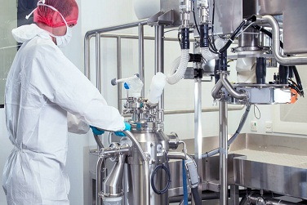
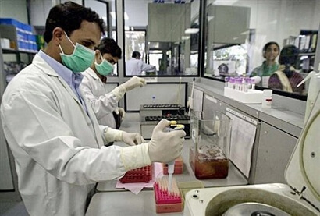
LABORATORIES :

Slide 26
Marketing Support :
We shall provide you the below mention promotional materials
Pharma Products Visual-Aid With Detail
Prescription Pad For Doctors And Chemists
Pharma Products Quality Paper On Demand Basis
Pharma Products Knowledge With Full Detail
Visiting Card
Web Site Support For Products Introduction In Market
Thanking Letter For Doctors And Chemist
Pens
Key Chain
Pen Stand
Company Product List
Pharma Products Marketing Bag
Gifts On Business Basis

Slide 27
BEST QUALITY PCD COMPANY AWARD :

Slide 28
THANK YOU

