Slide 1
Shree M. & N. Virani Science College (Autonomous)
“Yogidham Gurukul”, Kalavad Road, Rajkot, 360005
Presentation On Torrent Pharma Ltd.
PREPARED BY : KHAMBHALIYA VIVEK .S
EN NO : 19BIC022
PROGRAM : B.sc (INDUSTRIAL CHEMISTRY)
SEMESTER :5
SEMINAR : ITPR

Slide 2
INDEX
Introduction.
History.
Company Management Includes.
Mission & Vision.
Core Vlues.
Drug development process.
Torrent Pharmaceuticals some drug list.

Slide 3
INTRODUCTION OF COMPANY:
Torrent Pharma, the flagship Company of Torrent Group is one of the leading pharma companies of the Country.
The Company was a pioneer in initiating the concept of niche marketing in India and today is ranked amongst the leaders in therapeutic segment of cardiovascular (CV), central nervous system (CNS), gastro-intestinal (GI) and women healthcare (WHC).
Torrent Pharma's competitive advantage stems from the world-class manufacturing facilities, advanced R & D capabilities, extensive domestic network and a widespread global presence in over 40 countries.

Slide 4
History
Torrent Pharma started international acquisitions in 2005 with 90 year old Human from Pfizer to enter the German market. Later on purchased ANDA of Minocycline from Ranbaxy for the US Market in 2015.
In January 2018, Torrent also acquired Bio-Pharm, Inc. (BPI) a generic pharmaceuticals and OTC Company, based in Levittown Pennsylvania, USA, which also included a US FDA registered manufacturing facility.
Torrent Pharma is committed towards “not just healthcare but lifecare.”

Slide 5
COMPANY MANAGEMENT INCLUDES:
Sudhir Mehta
Markand Bhatt,
Pradeep Bhargava,
Shailesh
Haribhakti
Chairman
Director
Executive Vice Chairman
Independ ent Director
Samir
Mehra
Ashish Nanda,
Bhavna
Doshi

Slide 6
MISSION AND VISION OF TORRENT PHARMACEUTICALS LTD.

Slide 7
Core Values.
INTEGRITY
PASSION FOR EXCELLENCE
PARTICIPATIVE DECISION MAKING
CONCERN FOR SOCIETY & ENVIRONMENT :
FAIRNESS WITH CARE
TRANSPARENCY

Slide 8
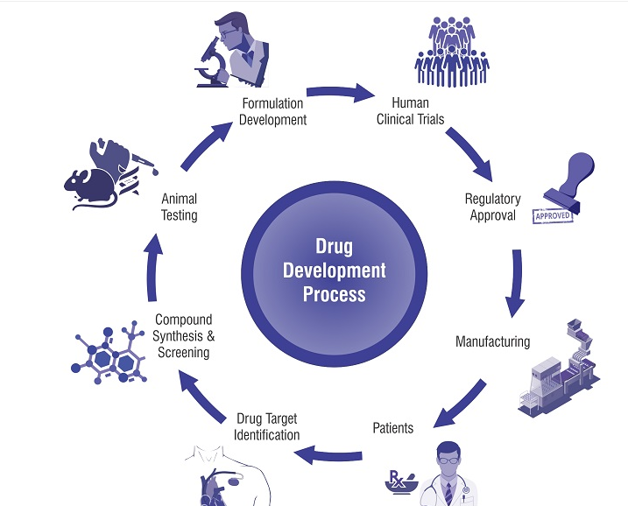
Drug Development process

Slide 9
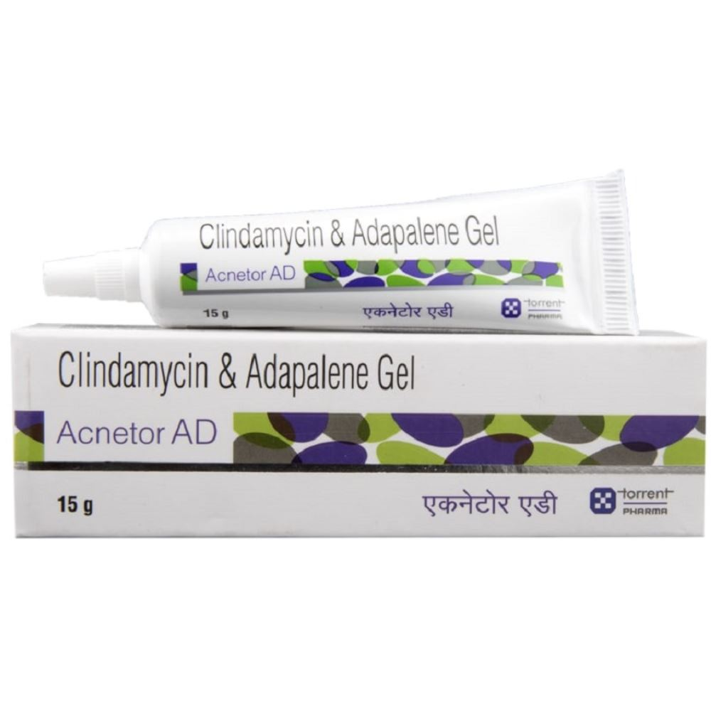
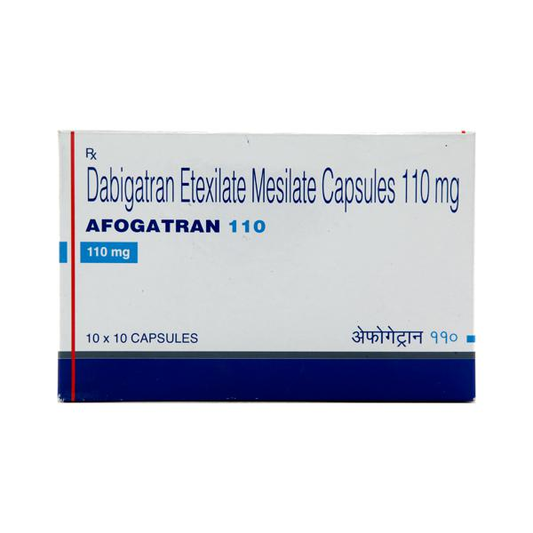
Torrent Pharmaceuticals some drug list
ACNETOR AD. (Acentor AD Gel 15gm)
AFOGATRAN. (Afogatran 110mg capsule)

Slide 10
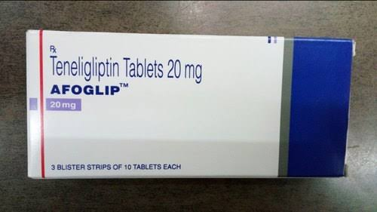
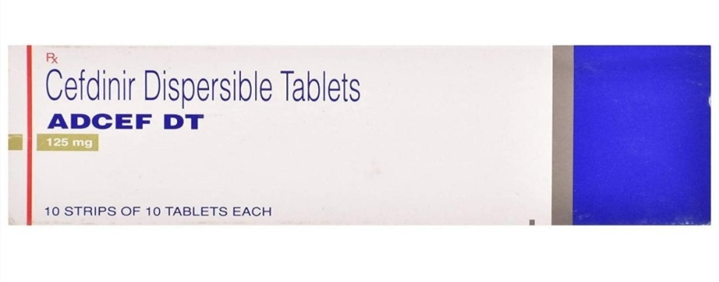
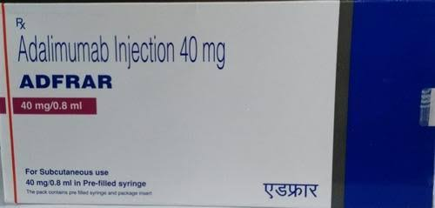
AFOGLIP
ADCEF DT. (Adcef DT 125mg Tablet)
ADFRAR P. (Adfrar p 40mg injection)

Slide 11
THANK YOU

