Slide 1
PLETHICO FARMA. Ltd.
Prepared by. : Sakhiya Nikhil J
Enrollment No.: 19BIC039
Department : B.Sc. Industrial chemistry (sem IV)
College : shree M & N virani science College

Slide 2
Detail
Chirag Patel is Chief Executive Officer Of Plethico Pharmaceuticals Ltd.
SECTOR : Health Care
SUB-INDUSTRY : Biotech & Pharma
INCORPORATED : 12/04/1991

Slide 3
PRODUCTS
Atenolol
Pyrazinamide
Ofloxacin
Isoniazid
Dimethicone
Diloxanide

Slide 4
6. Diloxanide
Diloxanide is a medication used to treat amoeba infections. In places where infections are not common, it is a second line treatment after paromomycin when a person has no symptoms. For people who are symptomatic, it is used after treatment with metronidazole or tinidazole. It is Taken by mouth.

Slide 6
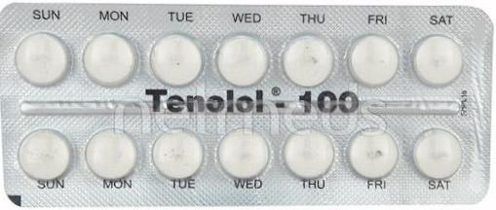
1.Atenolol
Atenolol is used to treat hypertension and angina and in stable heart attack patients to prevent death.

Slide 7
2.Pyrazinamide
Pyrazinamide kills or stops the growth of certain bacteria that cause tuberculosis (TB). It is used with other drugs to treat tuberculosis. This medication is sometimes prescribed for other uses

Slide 8
3.Ofloxacin
This medication is used to treat a variety of bacterial infections. Ofloxacin belongs to a class of drugs called quinolone antibiotics.

Slide 9
4. Isoniazid
Isoniazid is a prescription medicine used to treat the symptoms of Latent Tuberculosis Infection or Active Tuberculosis Disease.

Slide 10
5. Dimethicone
This medication is used as a moisturizer to treat or prevent dry, rough, scaly, itchy skin and minor skin irritations (e.g., diaper rash, skin burns from radiation therapy). Emollients are substances that soften and moisturize the skin and decrease itching and flaking

