Slide 1
Shree M & N Virani Science College (Autonomous) An affiliated to Saurashtra University Department of Industrial Chemistry
ITPR/ Seminar Presentation
Aarti Drugs Limited
Prepared By,
Rabadiya Pavan M.
19BIC036
Semester:-V

Slide 2
Outline
Introduction
Board of Directors
Awards & Accolades
Manufacturing plant
Timeline
Medicine & Uses
Vision and Mission

Slide 3
Introduction
Aarti Drugs Ltd. was established in the year 1984 in Tarapur. R&D plant of Aarti Drug in Tarapur Maharashtra near MIDC Location. The manufacturing-units of Aarti Drugs Ltd. Are GMP certified. The Company is also in the process of acquiring an ISO 9002 compliance for all its units and one of the units has already been approved.

Slide 4
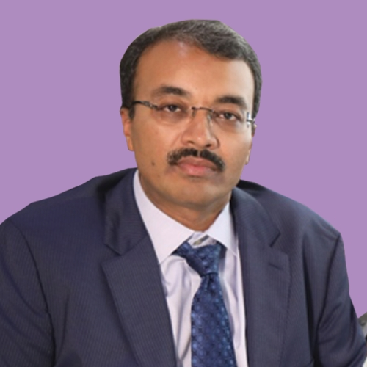
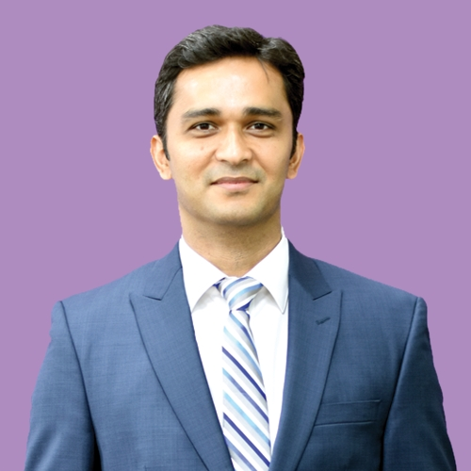
Board of Director
• Shri Prakash M. Patil,
Chairmain & CEO
• Rashesh C. Gogri
Managing Director
• Ashish P. Patil,
Chief Financial Officer

Slide 5
Awards & Accolades
CHEMEXCIL [ Outstanding Performance in Export.]
2001
2006
2014
2016
ORGANIZATION OF PHARMACEUTICAL PRODUCT [Best Vendor]
ABBOTT [Appreciation as business partner]
AVAYA GLOBAL CONNECT [Customer Responsiveness]
PHATMEXCIL [Outstanding Performance Latin American Export]
1992

Slide 6
Location
Head Office
Tarapur, Maharashtra
Manufacturing Plant
Tarapur
Thane, Mumbai
Development Centre
Pamthermbhi, Palghar
Sarigam, Valsad

Slide 7
Timeline of Aarti drugs
1984
Incorporation
1993
1996
1998
2003
2019
2011
Listed On BSE Ltd.
Amalgamation of Rupal Chemical Industries Limited, Rashesh Chemicals & Pharmaceuticals Limited, Manjarati Chemicals Private Limited, Manjarati Plastisizer Private Limited,
Turnover of Rs.100 Crore
Listed On National Stock Exchange Of India Limited
Turnover Of Rs.500 Crore
Turnover Of Rs.1500 Crore

Slide 8
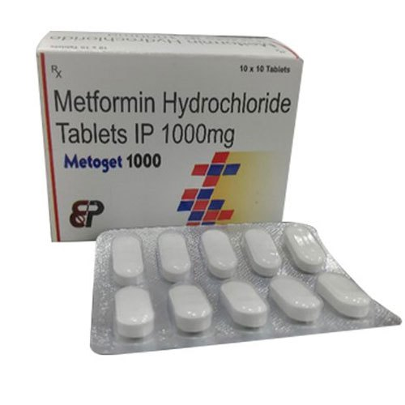
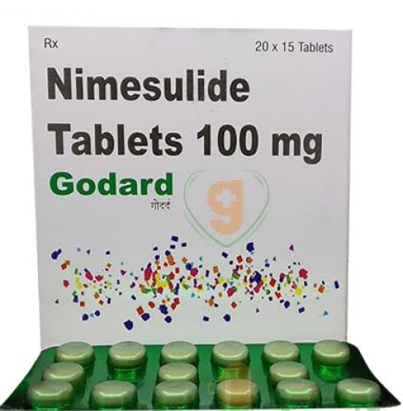
Medicine & Uses
Melformin Hydrochloride [ Controlling high blood Sugar & Helps Prevent Kidney Damage ]
Ketoconazole Cream [Foot, Jock itch, Ringworm, and Certain kinds of Dandruff]
Nimesulide Tablet [ pain relief and for the prevention of fever]

Slide 9
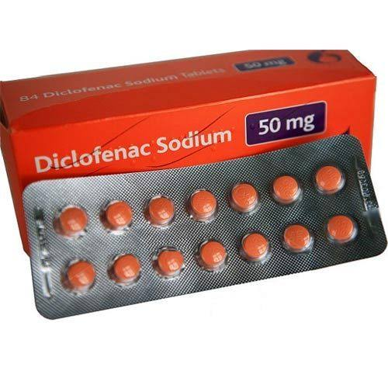
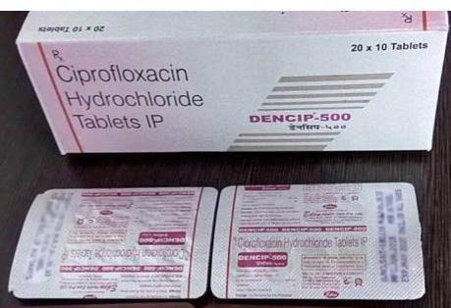
Tolnaftate Cream [ Treat skin infections ]
Disclofenac Sodium [ Relieve pain, reduce swelling and ease inflammation]
Ciprofloxacin Hydrochloride [Treat certain infections caused by bacteria such as pneumonia]

Slide 10
Mission
Focus on growth and development of the product. Strive for excellence in customer service, quality and R&D Department.

Slide 11
Vision
We Shall Become The First Choice Vendor Of Bulk Drugs And Achieve A Leadership Position & Assuring consistent quality and timely delivery at Competitive Price.

Slide 12
THANK YOU

