Slide 1
Shree M & N Virani Science College(Autonomous) an affiliated to saurashtra university Department of Industrial Chemistry
ITPR/Seminar Presentation
PATANJALI AYURVED
Prepared by:
Name: Tilala Ronak M.
Enrollment No.: 19BIC045
Semester – 5

Slide 2
PATANJALI AYURVED

Slide 3
HISTORY
Patanjali Ayurved (commonly known as Patanjali) is an Indian multinational consumer packaged goods company based in Haridwar, India. It was founded by Ramdev and Balkrishna in 2006. Its office is in Delhi, with manufacturing units and headquarters in the industrial area of Haridwar.

Slide 4
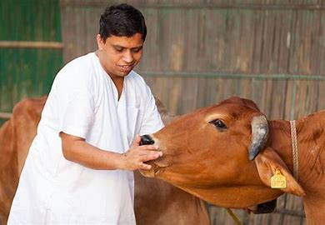

Slide 5
VISION
Keeping Nationalism, Ayurved and Yog as our pillars, we are committed to create a healthier society and country. To raise the pride and glory of the world, we are geared up to serve people by bringing the blessings of nature into their lives. With sheer dedication, scientific approach, astute planning and realism, we are poised to write a new success story for the world.

Slide 6
MISSION
Making India an ideal place for the growth and development of Ayurveda and a prototype for the rest of the world.

Slide 7
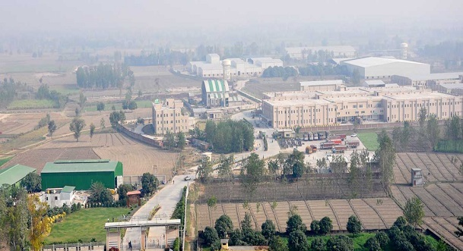

Slide 8
QUALITY OF PRODUCT
100% NATURAL
A high stress on quality, several quality circles and special quality circles and special project teams working on Total Quality Management (TQM) projects make quality a way of life in Patanjali Ayurved Nepal.

Slide 10
PRODUCTS

Slide 11
FOOD PRODUCTS

Slide 12
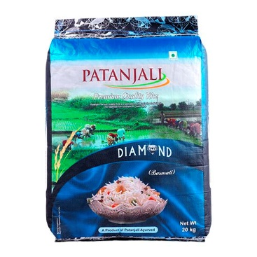

Slide 13
NON FOOD PRODUCTS

