Slide 1

Shree M. & N. Virani Science College(Autonomous)
An Affiliated to Saurashtra University
Department of Industrial Chemistry
ITPR / Seminar Presentation
Presented by:
MEET JANI
19BIC017
Semester : V

Slide 2
INTRODUCTION
Food and beverage company .
Headquartered in Switzerland.
Ranked #72 on the fortune global 500 in 2014.
Nestle’s products include baby food, bottle water, breakfast cereals, coffee and tea, confectionery dairy products, ice cream, frozen food and snacks .
Twenty-nine of nestle’s brands have annual sales of over CHF 1 billion (about US dollar 1.1 billion).
Nestle has 447 factories, operates in 194 country, and employs around 339000 people.

Slide 3

Name | Nestle S.A
Logo
Industries served | Food Processing
Geographic area served | Worldwide
Headquarters | Switzerland
Current CEO | Paul Bulcke
Revenue | CHF 92.2 BILLION (2012)
Profit | CHF 10.6 BILLION (2012)
Employees | 328000 (2012)
Main Competitor | Unilever VN, Hershey Foods, Kraft Foods, Cadbury, Group Danoe

Slide 4
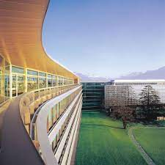
Did you know………..
Nestlé is a
Swiss company,
founded in 1866
by Henri Nestlé

Slide 5
Henri Nestlé, the founder
of Nestlé, was a life-saving
chemist but also an
innovative marketer.
He used scientific
knowledge to develop
products that met consumer
needs. He used his name
to brand his products in
a distinctive way. And he
set up systems to distribute
his products quickly
and effectively.

Slide 6
HISTORY
Henri nestle established nestle in 1867 in Switzerland (Vevey HQ)
His first product was lactogen formula for infants by the name “ farine lactee.”
In September 1866,in vevey, henri nestle developed milk –based baby food.
In august 1867,anglo-swiss condensed milk company was established.
In1875 henri nestle retired .but the company ,under ownership of daniel peter ,retained his name as societe farine lactee henri nestle.
in 1877 , anglo-swiss added milk based baby foods to their products. In the same year nestle company added condensed milk to their portfolio.

Slide 7
In 1904, Both companies participated in the creation and development of Swiss chocolate and Nestle marketing the first chocolate – milk Nestle .
In 1905, the companies merged to become the nestle and Anglo-Swiss condensed Milk Company and retaining the name until 1947.
In 1947, Merger with Alimentana S.A. (Maggi) and company named as Nestle Alimentana S.A. 1971.
In 1974, Become stakeholder of L’Oreal .
1977 Acquisition Alcon Laboratories Inc.
1985 Acquisition of carnation.
1988 Acquisition of Rowntree.
1990 Cereal partners Worldwide.

Slide 8
1991, Beverage partners worldwide.
1998, Acquisitions of spillers Pet foods.
2002, Acquisitions of Ralston Purina
2002, Acquisitions of and Chef America and merge into Dreyer’s
2002, join Cadbury and purchased American company Hershey’s
In December 2005, Nestle bought the Greek company Delta Ice Cream for €240 million.
In January 2006, it took full ownership of Dreyer’s Grand Ice Cream Holdings, Inc.
In November 2006, Nestle purchased the Medical Nutrition division of Novartis Pharmaceutical for US$2.5 billion.
2007 Acquisitions of Ovaltine.

Slide 9
In April 2007, Nestle bought US baby-food manufacturer Gerber for $5.5 billion.
1 March 2010, Bought Kraft’s Food (Frozen Pizza) for $3.7 billion
In February 2013, Nestle Health Science bought Pamlab.
In February 2014, Nestle sold its Power Bar sports nutrition business to Post Holdings, Inc.
In December 2014, Nestle announced that it was opening 10 skin care research centers worldwide
2015, opening of Education and Longevity Development (SHELD) centers

Slide 10
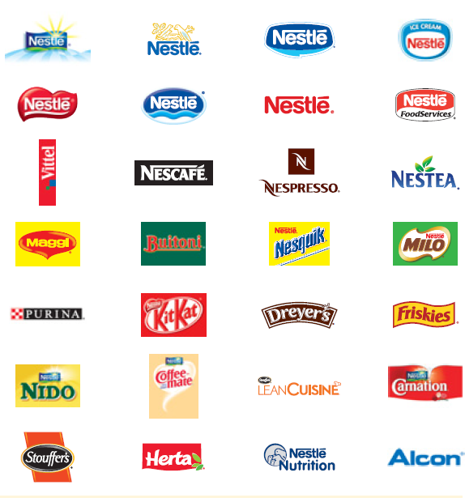
  The Nestlé Company is built on the foundation of very strong brands. Some are global, others are regional, and many are local to a specific country.

Slide 11
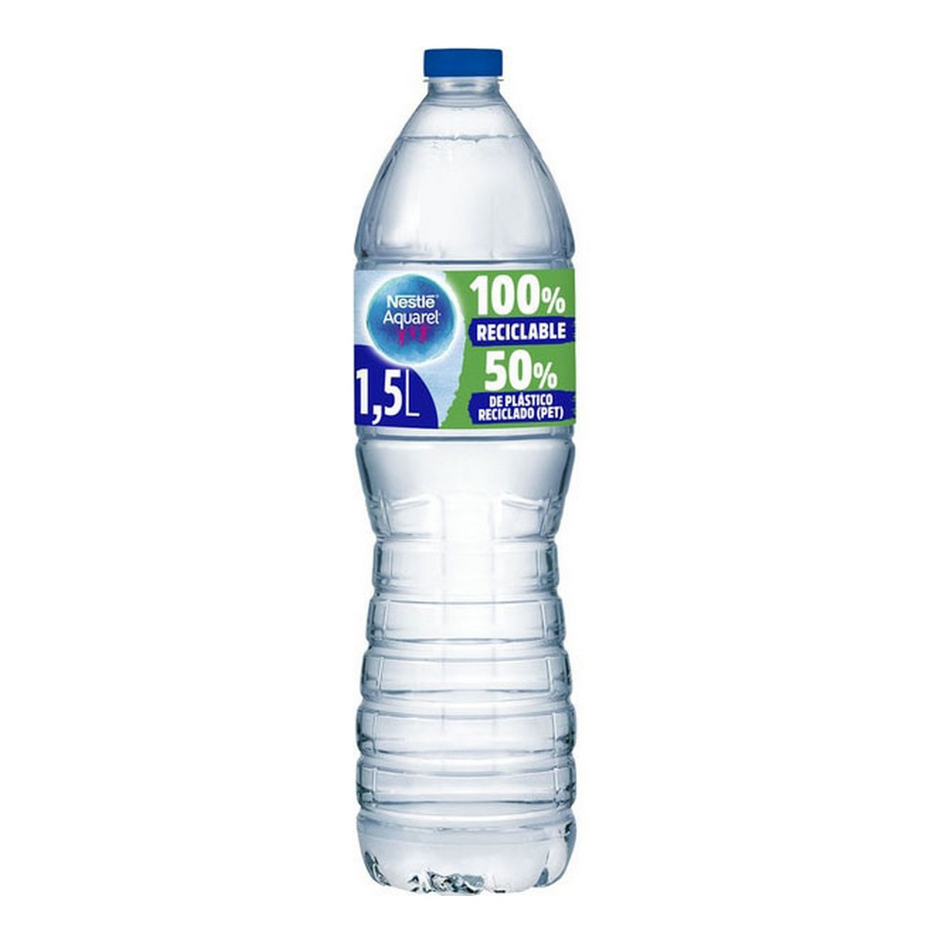
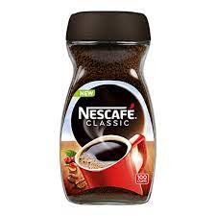
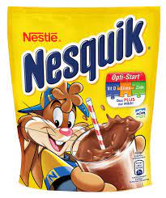
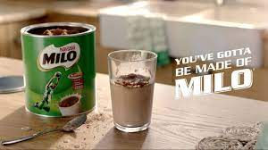
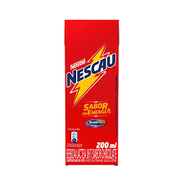
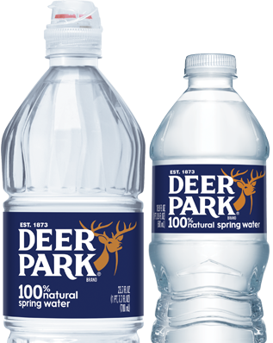
Beverages
Nescafe
Nespresso
Nesquik
Milo
Nescau
Deer Park
Aquarel
Vittel

Slide 12
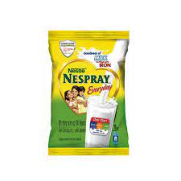
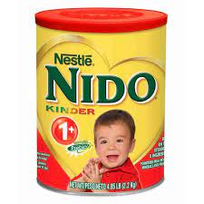
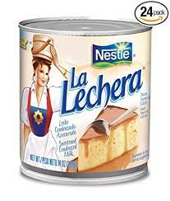
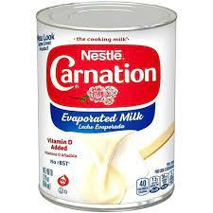
Milk products, nutrition and Cream products
Nido
Nespray
La Lechera
Carnation

Slide 13
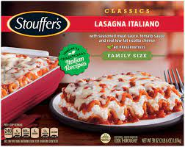
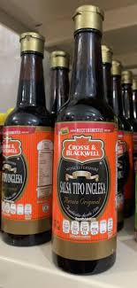
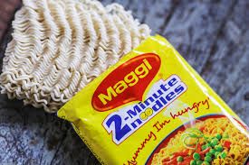
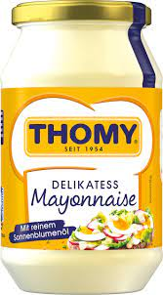
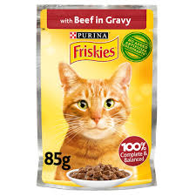
Prepared dishes, cooking aids and pet care
Maggi
Stouffer’s
Buitoni
Herta
Thomy
Crosse and Blackwall
Winiary
Friskies

Slide 14
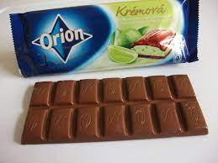
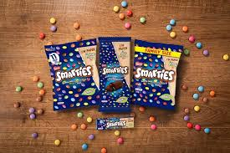
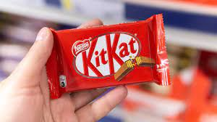
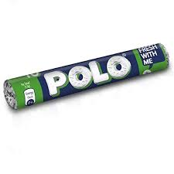
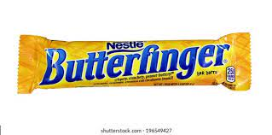
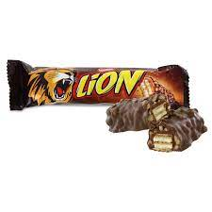
Chocolate, confectionery and biscuits
kitkat
Smarties
Lion
Crunch
After Eight
Polo
Orion
Butterfinger
Cailler
Star

Slide 15
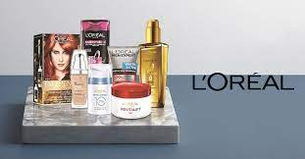
Cosmetics
L’OREAL

Slide 16
Organizational Hierarchy:
NATIONAL
MANAGER
ZONAL
MANAGER
REGIONAL
MANAGER
SALES
ADMINISTRATION
EXECUTIVE
AREA
SALES
MANAGER
TERRITORY
INCHARGES
SALES
DISTRIBUTION
STAFF

Slide 17
To give an idea of the scale of Nestlé’s environmental
improvements, during a recent four year period they
reduced water consumption in their factories by 42%,
energy consumption by 30%, and emissions of
greenhouse gases by 34%

Slide 18
Mission Statement
“We strive to bring consumers foods that are safe’ of high quality and
provide optimal nutrient to meet physiological need. Nestle helps provide
selections for all individual taste and lifestyle preferences.”
Motto :
“GOOD FOOD, GOOD LIFE.”

Slide 19


