Slide 1
SHREE M. & N. VIRANI SCIENCE COLLEGE Faculty of Science DEPARTMENT OF INDUSTRIAL CHEMISTRY ITPR/SEMINAR PRESENTATION JAGSONPAL PHARMACEUTICALS LTD.
Prepared by:
Name:-Ubhadiya Shivam R.
Enrollment No:-19BIC046
SEM:-5

Slide 2
OUTLINE
Company Profile
Introduction
Board of directors
Manufacturing units
Products
Finantial activities

Slide 3
COMPANY PROFILE
Industry founded:
Pharmaceutical 1964
Headquarter:
Haryana , India
Key people:
Mr.Rajpal Singh Kochhar (chairman)
Capt. Bharat Sinh (Director Financial)

Slide 4
INTRODUCTION
The legacy of Jagsonpal Pharmaceuticals Limited (JPL) dates back to over 58 years.
JPL Established in 1964 with an objective to develop and revolutionize the Pharmaceutical and Drug industry in the indian subcontinent.
The headquarter of jagsonpal pharmaceutical at delhi.

Slide 5
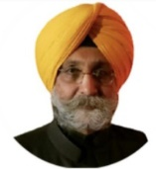
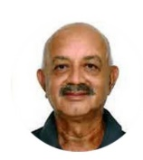
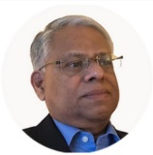
BOARD OF DIRECTORS
Mr.Rapala Singh Kochhar
(Chaorman & CEO)
Capt. Bharat Sinh
(Director Financial & CFO)
Mammen Mathew
(independent Director)
Dr. Ashore Kumar Pati
(Independent Director)
Dr. Ishpal Singh Ghai
(Independent Director)

Slide 6
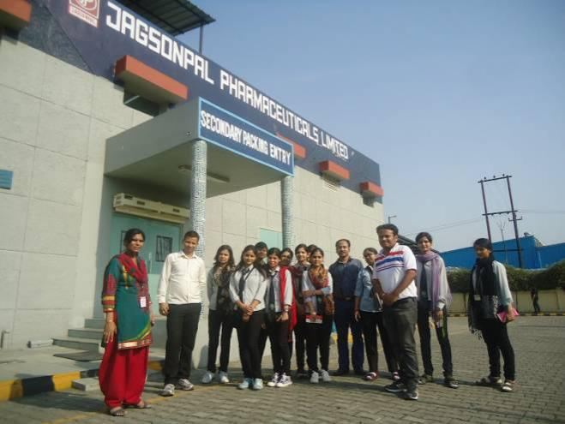
Manufacturing Units
Shahpur Jati, New Delhi

Slide 7
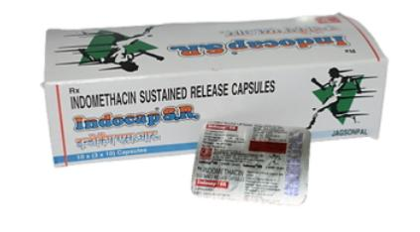
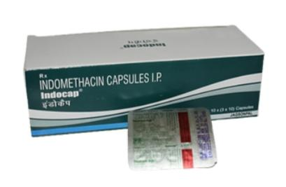
PRODUCTS
Inocap SR Capsule
Containe :- Indomethacin (75 mg)
Uses :- Reduce Fever , Body Pain
Indocap Capsule
Containe :- Indomethacin (25 mg)
Uses :- Reduce Fever , Body Pain

Slide 8
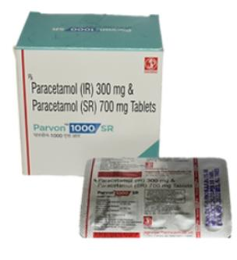
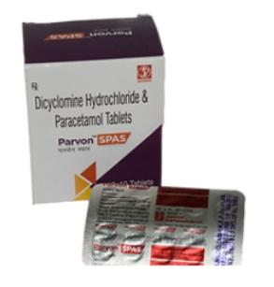
PRODUCTS
Parvon – 1000SR
Containe :- Paracetamol
Uses :- Pain killer , Reduce fever
Parvon spas
Containe :- Dicyclomine
Uses :- Realex the muscle in stomach

Slide 9
FINANCIAL ACTIVITIES
 | DECEMBER 2020 | DECEMBER 2021
TOTAL INCOME | 57.64 CR | 56.43 CR
TOTAL INCOME GROWTH(%) | 1.54 % | -5.60 %
TOTAL EXPENSES | 50.90 CR | 49.23 CR
EBIT | 6.74 CR | 7.19 CR
EBIT GROWTH | 35.59 % | -30.41 %
PROFIT AFTER TAX | 5.43 CR | 5.41 CR
NET PROFIT MARGIN | 9.42 CR | 9.58 CR

Slide 10
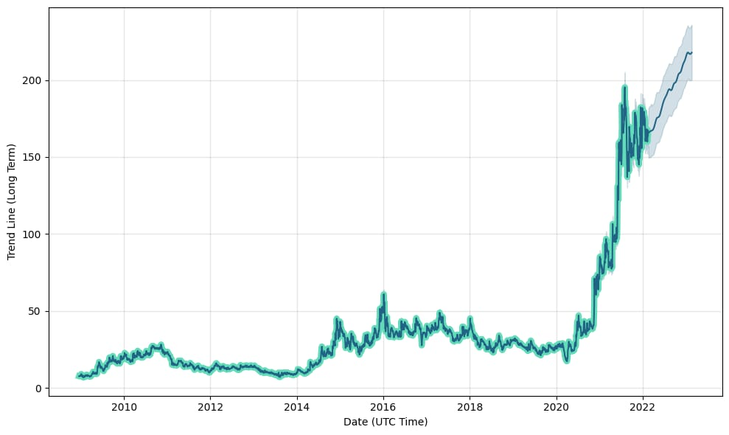
LAST 12 YEAR FINANCIAL DATABASE

Slide 11
THANKS YOU

