Slide 1
Name : jaydip kagathra subject : itpr enrollment no : 19bi019 company : themis medicare pvt.ltd shri m.n. virani science college autonomus

Slide 2
ABOUT COMPANY
Three young pharmacy graduates envisioned a future in the Indian pharmaceutical industry. Together, they co-founded a company and a vision Therapeutic Pharmaceuticals. Shantibhai , Kantibhai and K. P. Menon contract manufactured their first preparation - ISOPASCAL-CD in tablet form for use in treatment of Tuberculosis.
Overtime, they setup their own manufacturing facility in Andheri , Mumbai (India), adding several new products to their basket. One of their first well established and popular brands was Metacin (Paracetamol).

Slide 3
MISSION & VISSION
"Our Mission" is to benefit patients.
"Our Vision" is to develop targeted medicines that offer patients and physicians better, safer, more cost-effective healthcare.

Slide 4
Andhra Pradesh : Vijaywada
Assam : Guwahati
Bihar : Patna
Chandigarh : Chandigarh
Chhatisgarh : Raipur
Gujarat : Ahmedabad
Jharkhand : Ranchi
Karnataka : Bengaluru
Kerala : Kochi
Madhya Pradesh : Indore
Maharashtra : Mumbai, Bhiwandi
New Delhi : Delhi
Oddisha : Cuttack
Rajasthan : Jaipur
Tamil Nadu : Chennai
Telangana : Hyderabad
Uttar Pradesh : Ghaziabad

Slide 5
Algeria , Brazil ,Canada ,Chile ,Germany ,Greece , Hungary, India, Indonesia, Ireland , Italy, Jordan ,Kenya ,Kuwait ,Morocco ,Nigeria ,Philippines ,Poland ,Saudi ,South Korea ,Spain ,Sri Lanka ,Switzerland

Slide 6
ANTIBIOTICS
Notes:
ANTIBIOTICS

Slide 7
QUALITY ASSURANCE
They, at Themis , believe that Quality is embedded in our daily routine and deep into our organization. The culture of Quality comes from the top and is patient-centric.
Their Quality Team ensures that every product manufactured and distributed by us complies with domestic and internationally accepted good manufacturing practices and standards of quality, efficacy, purity and safety.

Slide 8
Their commitment to quality goes beyond ourselves. When it comes to quality, the only preference is quality. Our quality standards are continuously being improved upon and are constantly benchmarked against global practices.
They remain committed to the highest levels of quality and will ensure that all our facilities continue to meet the regulatory standards that are expected of a global pharmaceutical company.

Slide 9
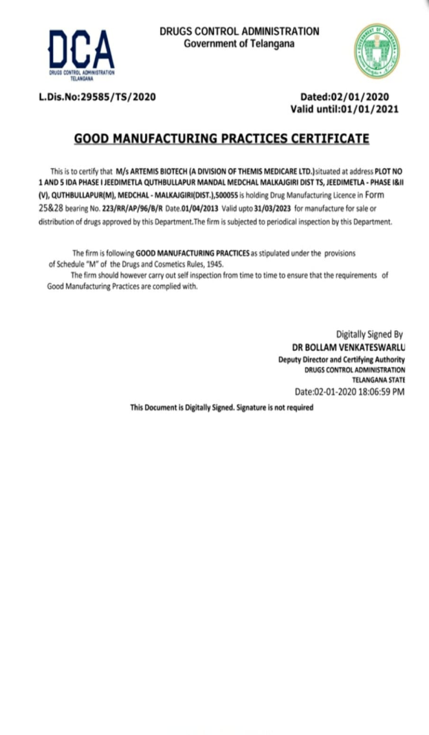
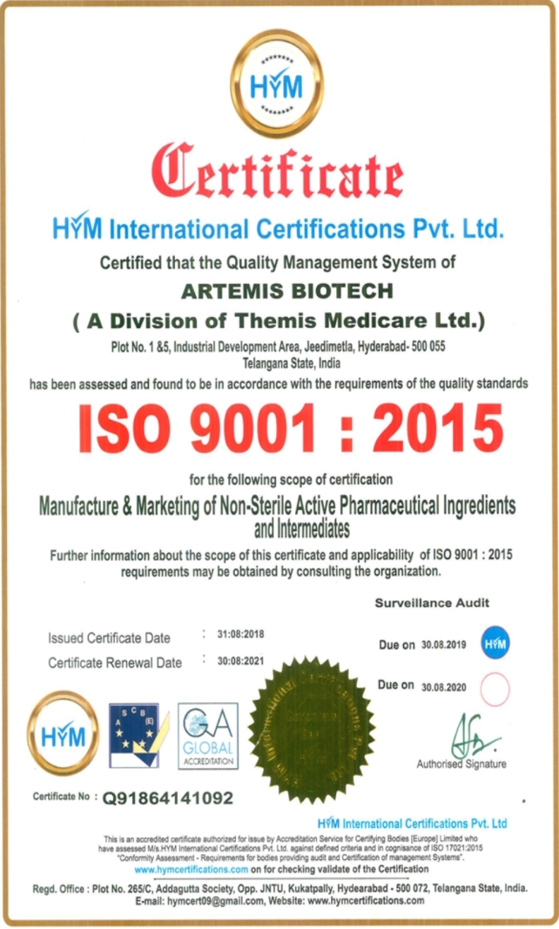
CERTIFICATES
CDSCO Certification, India
GMP Certification
ISO Certification 9001 : 2015
CDSCO Certification, India
GMP Certification
ISO Certification 9001 : 2015

Slide 10
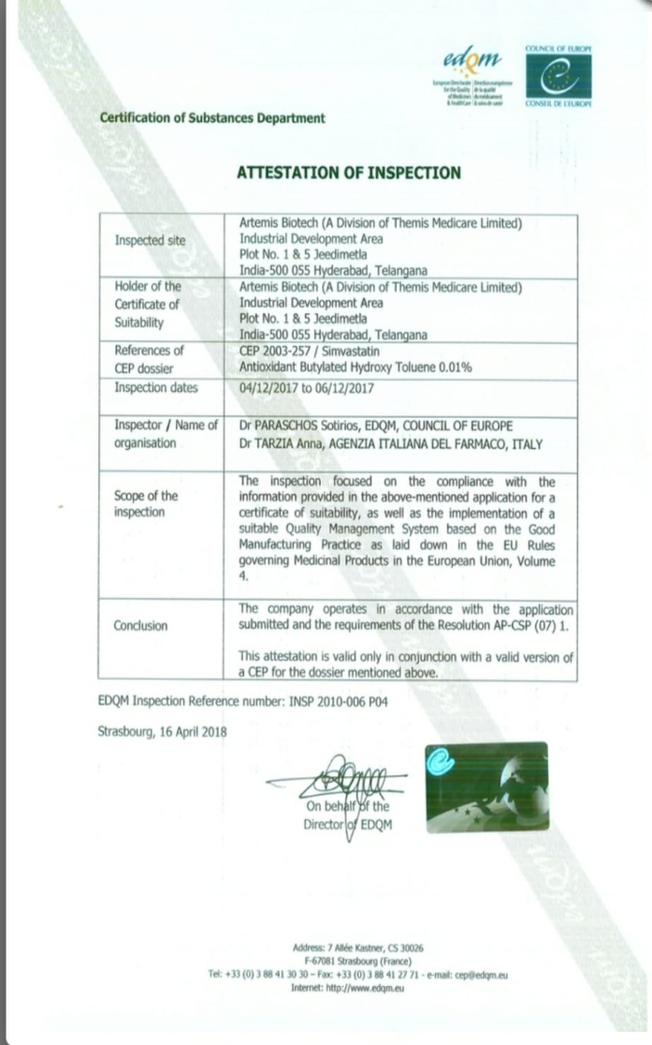
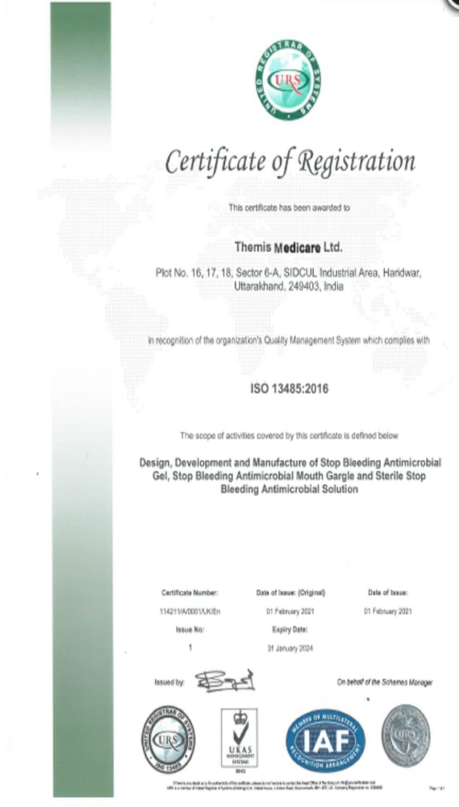
GMP Certification, Italy
Attestation of Inspection
ISO 13485 - 2016

Slide 11
THANK YOU

