Slide 1
WELCOME

Slide 2
Arvind Remedies Ltd.
Department of Industrial Chemistry
ITPR / Seminar Presentation
Prepared by:
Gohel Kishan N.
19BIC014
SEM-5

Slide 3
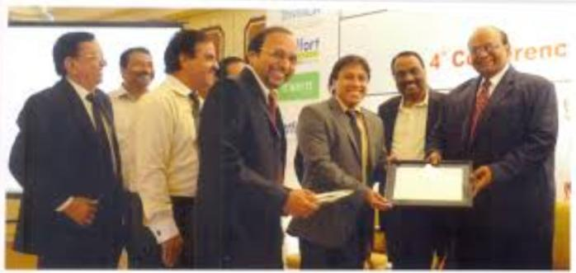
History
The company was incorporated on 17.6.1988 in Chennai as a private limited company under the name Arvind Remedies Pvt. Ltd.
Subsequently it was converted into a public limited company by passing a special resolution 7th April 1995 and obtaining a fresh certificate of incorporation on 18th May 1995 and consequently the name change.
Arvind company was Incorporated by Mr. Arvind Shah, Managing Director and CEO.

Slide 4
1995 : The company is converted to Limited company
2013 : Sign Memorandum of Understanding (MoU) to manufacture and Market drugs with four educational institutions
Arvind Remedies Ltd : Caring for your Health
2001 : Issues rights of 1,486,000 equity shares
2012 : Receive the Pioneers Award for excellence in healthcare
2002 : Issues bonus shares at the ratio of 5 shares for equal 2 shares held

Slide 5
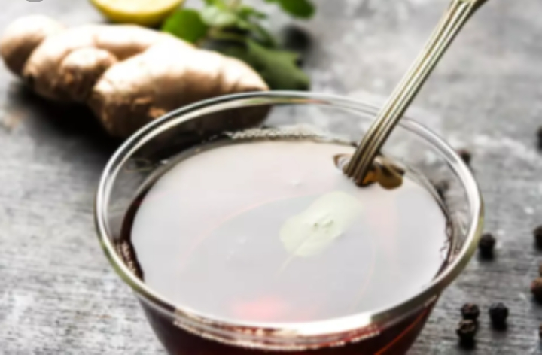
About
Company set out to manufacture and Market world-class allopathic and Ayurvedic pharmaceutical products within and outside India, bringing high quality healthcare to the common man.
Having grown in terms of production capacity, product categories, market share, advancements in research and development (R&D), market reach and global acceptance, the company is presently a significant force to reckon with in the Indian pharmaceutical industry.

Slide 6
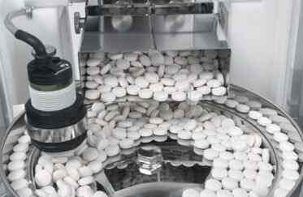
Contributions and supply
The company core strength lies in the ability to deliver both Western and Eastern varieties of quality treatment and it has made significant contributions to the fields of Cardiology, dermatology, nephrology and diabetes, among others.
Arvind exports its products of Africa, Commonwealth of Independent States and Asia and has started to register its products in several countries, including Malaysia, Tanzania, Sri Lanka, Ukraine, Nigeria and Nepal.

Slide 7
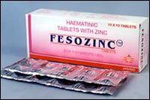
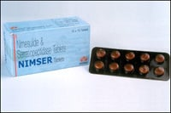
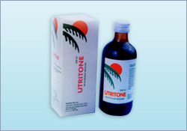
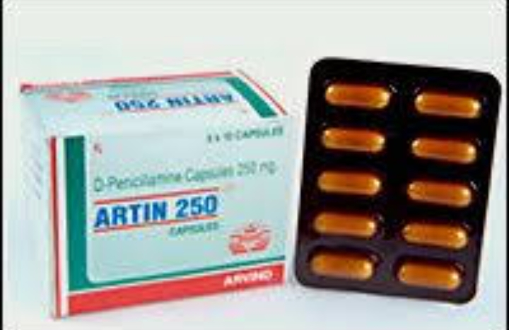
Products
FESOZINC
NIMSER
UTRITONE
ARTIN 250
SOREXIL

Slide 8
Allopathy
Focus on the launch of new combination drugs through the Novel Drug Delivery Systems (NDDS).
Enhance the presence in the domestic branded market :-
Introduction of new generation molecules.
Acquisition of new brands.

Slide 9
Ayurvedic
Setting up of a dedicated, totally self- dependent modern Ayurvedic facility in conformity with International standards to become a global pharma player.
Penetrating into the global market through :
Marketing tie ups with national and multinational companies
Setting up of branch offices abroad.
Intense focus on export of herbal products to the highly profitable, growth oriented European and US markets.

Slide 10
Company description :

Slide 11
Vision & mission
Arvind Remedies to be a global player in the pharmaceutical industry by manufacturing and marketing quality medicinal products both in Allopathy and Ayurveda.
Service to humanity through quality medicines to the ailing.
Create values for shareholders.

Slide 12
Safety & health
Regular training
Knowledge Up gradation
Doctors on roll
Ambulance at side
Trained and dedicated safety terms at facilities

Slide 13
Thank you

