Slide 1

Welcome

Slide 2








ITPR Seminar Presentation
Ami Life Science Pvt. Ltd.
Company Profile
Prepared By
Theshiya Ashray A.
Industrial Chemistry(V-Semester)
19BIC044

Slide 3






About
History
Location
Our Purpose
Corporate Executive Team
Financial Information
Environment, Health & Safety

Slide 4
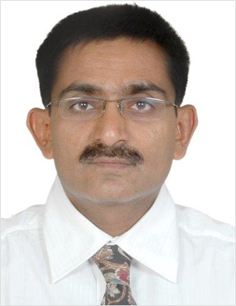
History
Ami Lifesciences Pvt Ltd is an unlisted private company incorporated on 02 March, 1994. It is classified as a private limited company and is located in Vadodara, Gujarat.
The company has 5 directors/key management personal Girishkumar Limbabhai Chovatia, Shivani Rudreshkumar Trivedi, Nareshkumar Ramjibhai Patel, Karamshi D Pidhadia, and Kalpesh Ravajibhai Patel. Ami Lifesciences Pvt Ltd company registration number is 021470 and its Corporate Identification Number(CIN) provided from MCA is U24110GJ1994PTC021470.
Mr. Girish Chovatia

Slide 5

Middle East Region (e.g. UAE); North America (USA, Canada); Central America (e.g. Mexico); East Asia (e.g. China, Japan, Korea); Europe - EU countries; Europe - non EU (e.g. UK, Russia, ex-CIS countries); South America (e.g. Brazil, Colombia); South Asia (e.g. India, Sri Lanka); South East Asia (e.g. Thailand, Philippines, Singapore)

Slide 6
Location
Corporate Office
Manufacturing Unit
Marketing Office
2ND Floor, Prestige Plaza,
40, Urmi Society, Nr. Urmi Cross Road,
BPC Road, Akota, Vadodara-390 020.
Gujarat, INDIA.
Block No.82/B, ECP Road,
At & Post. Karakhadi-391450
Taluka : Padra
Dist : Vadodara Gujarat, INDIA.
305,Nitco Biz Park,3rd Floor,
Road No.16, Wagle Estate,
Thane (W) 400 604
Maharashtra, INDIA

Slide 7
Our Purpose
We improve people’s lives by redefining how medicines and health products are delivered.
Ami Lifesciences was founded with the goal of changing the way in which quality medicines are delivered to people in need. We operate on the principle by extending our focus and services to maximize our impact on the global pharmaceutical industry.
We have spent last two decades in building up our scientific and technological capabilities, research, and manufacturing competencies. Along the way we have earned a reputation for being innovative, inventive and resourceful. We have built long term business association pharmaceutical companies of the world.

Slide 8
Corporate Executive Team
Mr. Nikhil Dedhia - Director Global Business
Mr. Ramesh Vekaria – Director Supply Chain
Mr. Rajesh Pansuriya - Manufacturing Head
Mr. Virendra Thakrar – Senior Scientist, R & D
Mr. Yogesh Katharotiya – QC Head
Mr. Rajib Das – QA Head
Mr. Kinchit Shah – Activities Of Daily living Head
Mr. Kirit Dharawat - CFO
Mr. Chirag Amin - CHRO Head

Slide 9
Financial Information
The financial information derived from the audited financial statements of Ami Lifesciences Private Limited for the last three financial years (i.e. for the Fiscals 2020, 2019 and 2018) are set forth below:
Particulars | For the Fiscals
 | 2020 | 2019 | 2018
Equity capital | 123.53 | 100 | 100
Reserves and surplus (excluding revaluation reserves) | 2,938.99 | 878.11 | 694.17
Sales | 3,954.70 | 2,828.34 | 2,288.24
Profit/(loss) after tax | 509.3 | 262.34 | 193.82
Earnings / (Loss) per share (face value 10) (Basic) | 49.25 | 26.23 | 19.38
Earnings per share (face value 10) (Diluted) | 49.25 | 26.23 | 19.38
Net asset value | 3,062.52 | 978.11 | 794.17
Net asset value per share | 247.92 | 97.81 | 79.42

Slide 10

Environment, Health & Safety
We make products that promote health for people, in a manner that keeps the environment healthy and our workers and people safe.
Our Environment, Health, and Safety efforts are geared to maintain low impact on the ecology, full safety for our employees and people from communities nearby as well as positive impact on health of our people.

Slide 11
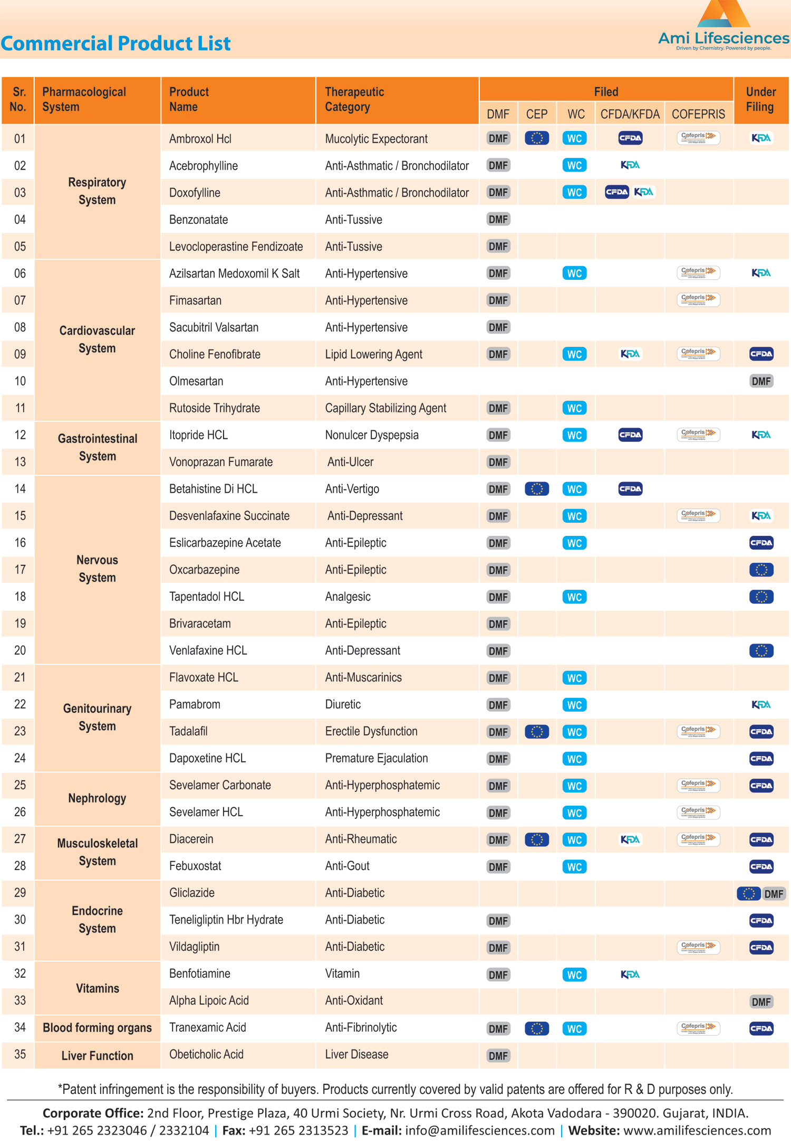

Slide 13

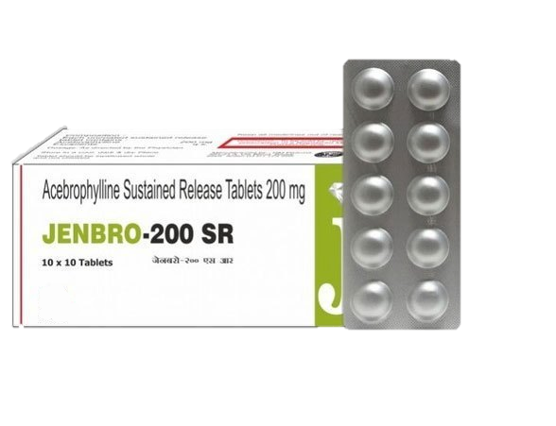
Uses of Acebrophylline
It is used for treatment of adult patients with COPD and bronchial asthma
How does Acebrophylline work?
It works by dilating the airway tubes and breaking down the mucus
Content:- Acebrophyline
Usage Instructions for Acebrophylline
To gain the most benefit, take the medicine daily or as prescribed by your doctor. Take with or without food. Take with food if it causes an upset stomach. Do not crush or chew.
Common Side Effects
Belly pain or heartburn, loss of appetite, diarrhea, or vomiting
Food Restrictions :- Avoid Alcohol
Acebrophylline Storage Instructions
Store in a cool, dry place away from the reach of children. - Medicines must not be used past the expiry date.

Slide 14
API Underdevelopment
Sr. No. | Product Name | Therapeutic Category
01 | Bempedoic Acid | LipidLowering
02 | Bilastine | Anti-Histamine
03 | Ezetimibe | LipidLowering
04 | Folic Acid | Vitamin
05 | Rivaroxaban | Anti-Coagulant
06 | Sitagliptin | Anti-Diabetic
07 | Dapagli?ozin | Anti-Diabetic
08 | Ticagrelor | Anti-Coagulant
09 | Edoxaban | Anti-Coagulant
10 | Roxadustat | Anti-Anemia
11 | Clindamycin | Anti-Bacterial
12 | Valsartan | Anti-Hypertensive
13 | Tegoprazan | Anti-Ulcer
14 | Empaglimozin | Anti-Diabetic
15 | Mirabegron | Anti-Muscarinics
16 | Lurasidone HCl | Anti-Psychotic
17 | Vadadustat | Anti-Anemia
18 | Mirogabalin | Anti-Convulsant
19 | Citicolin sodium | Anti-Psychotic
20 | Imeglimin | Anti-Diabetic

Slide 15
Manufacturing Facility
Ami Lifesciences API plant is located at Karakhadi, Vadodara, a city around 450 kms away from the financial capital of India – Mumbai. It is easily accessible by Air, Road, and Rail. The manufacturing unit has a total land area of 26,000 sq. meters and manufacturing capacity of 200 M3. The Facility is fully licensed as per the Indian factory Act and it is Compliant with and approved by EU-GMP, WHOGMP, PMDA, TFDA, COFEPRIS, IRAN MOH, etc.
The Plant has clean Rooms for API and has infrastructure and equipment's for a large spectrum of reactions. The plant also has a separate Microbiological Laboratory Microbiological Laboratory for carrying out Bacterial, Fungal and Pathogen tests.
Our Laboratory is made up of properly Coved Epoxy Flooring, with HVAC systems and Dynamic Pass Box for the movement of samples and media, The walls are painted with the Antifungal paints and are periodically fumigated to ensure the sterile environment.

Slide 16
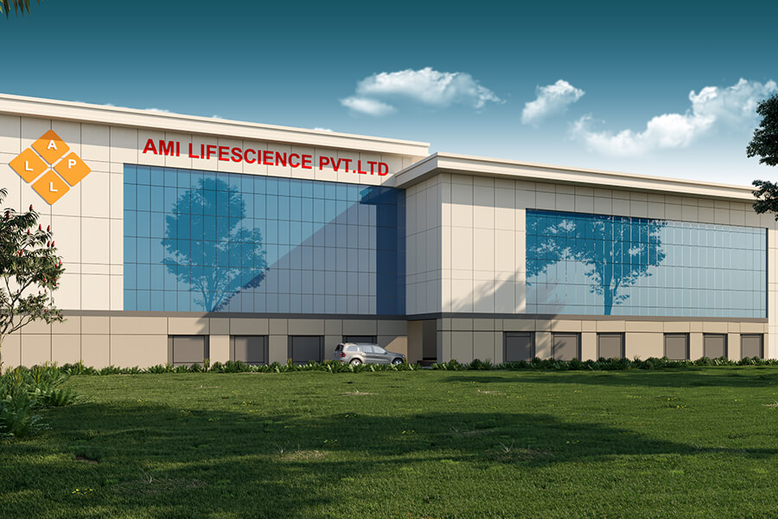
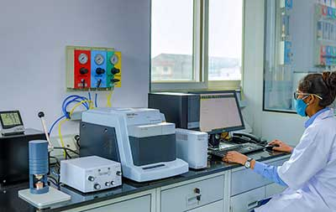
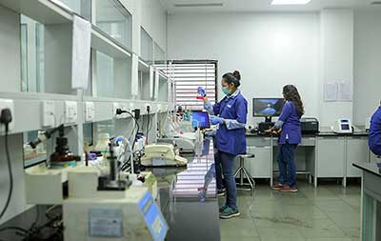
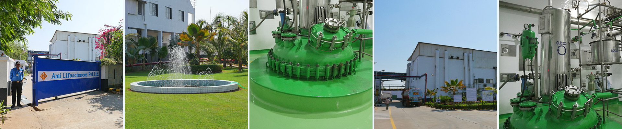

Slide 17

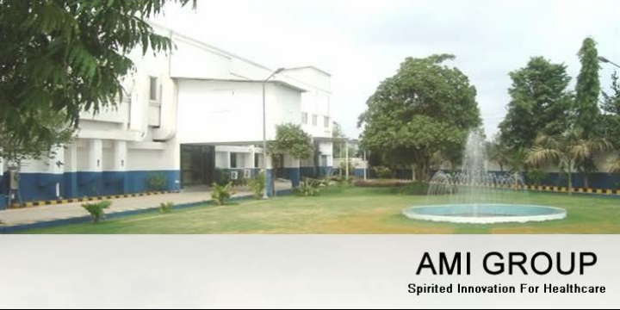
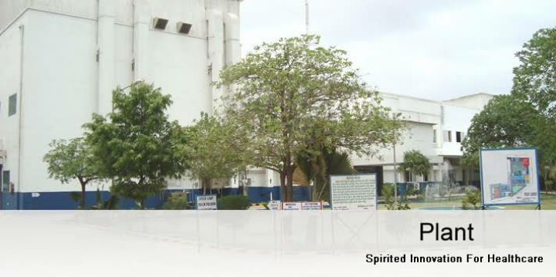
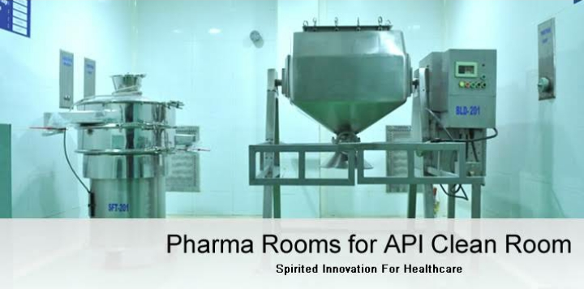
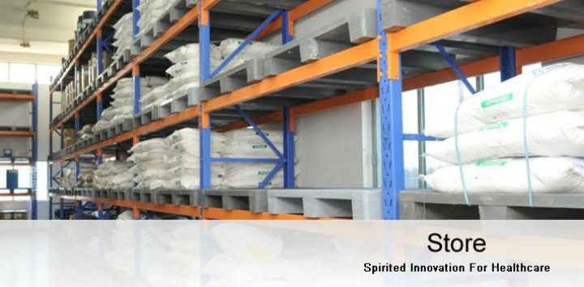

Slide 18
Our R&D Labs engage more than 45 experienced chemists and scientists and is well equipped with Modern Fume Hood Systems, Auto Claves, High Vacuum Distillation Assembly, Large flasks and Glass reactor assembly from 250 ml to 10 liters volume and Vacuum Tray Dryers.
The different kinds of reactions we can handle
Acetal Formation
Arylation
Acylation
Addition Reaction
Alkylation
De-Alkylation Cleavage
Condensation
Decarboxylation
Dehydration
Esterification / Trans-esterification
Formylation
Cyclization

Slide 19



Slide 20
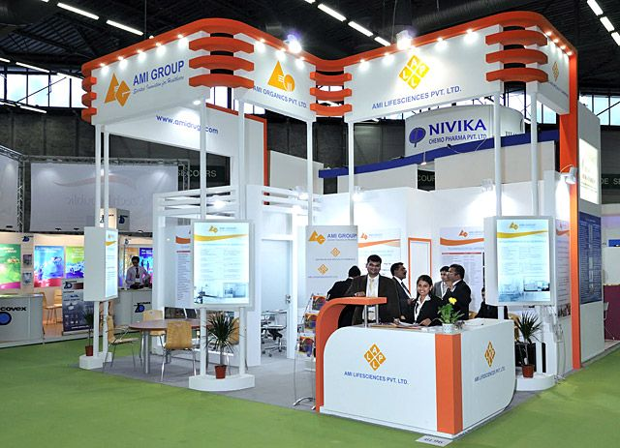

Slide 21
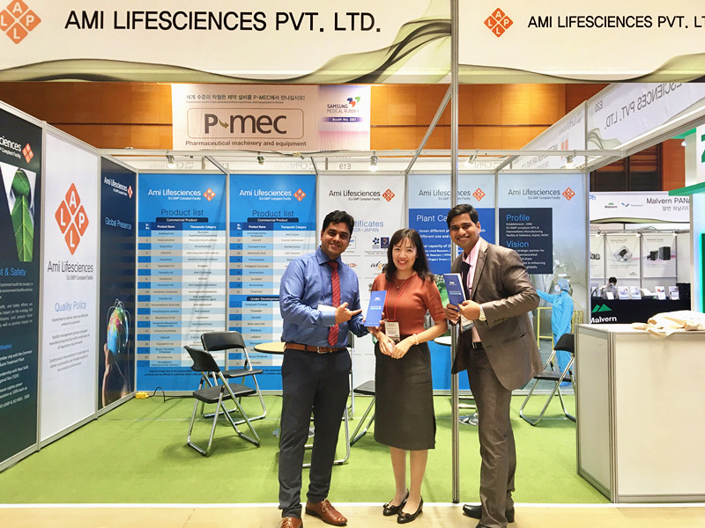

Slide 22



Slide 23
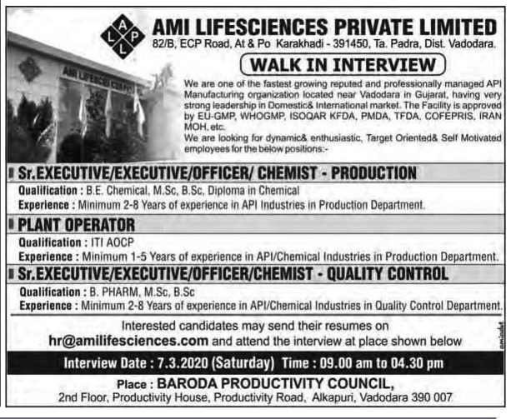

Slide 24

Thank you

