Slide 1
Shree M & N Virani Science College (Autonomous) An affiliated to Saurashtra University Department of Industrial Chemistry
ITPR/ Seminar Presentation
Macleods Pharmaceuticals Ltd.
Prepared By,
Sarvaiya Karmdeepsinh R.
19BIC041
Semester:-V

Slide 2
WEL-COME

Slide 3
OUTLINE
Introduction
Board of Directors
Milestone
Manufacturing plant
Timeline
Global Presence
Medicine & Uses
Vision and Mission

Slide 4
INTRODUCTION
Established in 1986, we specialise in the development and manufacturing of APIs and finished dosage pharmaceutical formulations. Our values transcend mere profits and guide us in fulfilling our responsibility towards society.
What truly sets us apart from many others in the Indian pharmaceutical space is a unique and diversified product portfolio! Our India operations comprise of several business units that focus on specific therapeutic segments and share strong bonds with the medical fraternity, thus enhancing market penetration along the way. Today, many of these business units have brands that have become market leaders themselves.
company produces generics for a range of diseases including asthma osteoporosis and diabetes.

Slide 5
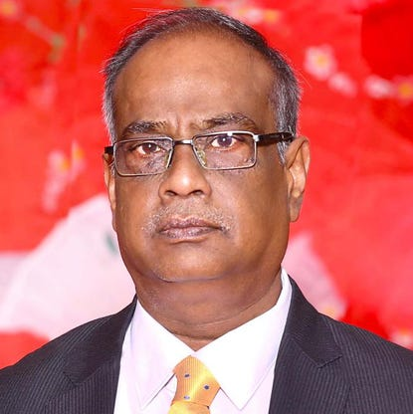
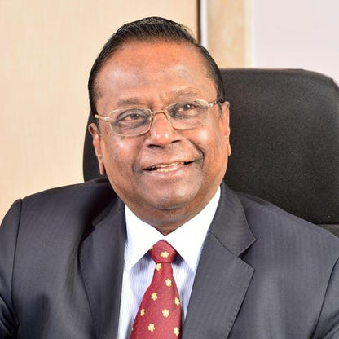
BOARD OF DIRECTORS
Banvarialal Bawari
Managing director of macleods
pharmaceuticals.
Girdharilal Bawari
Chairmen of Macleods
Pharmaceuticals.

Slide 6
》MILESTONE
Incorporation
2000
2005
2013
2014
Started new facilities of daman
Launched own operations in USA
Established CRO in mumbai
Launched own operations in South Africa
1985

Slide 7
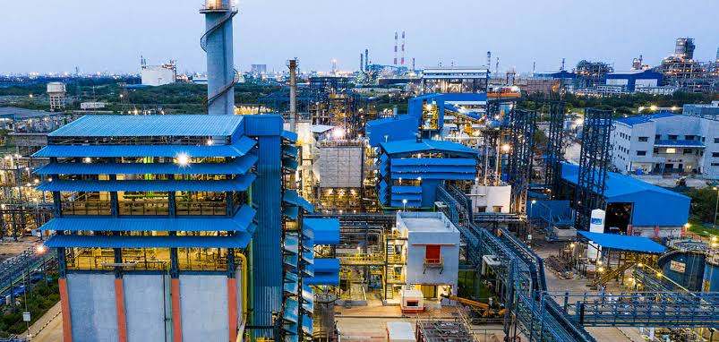
Location
Dahej
Gujrat
Mumbai
Maharashtra
INDIA
Maharashtra
Gujrat
Vapi

Slide 8
》PRODUCTION FORMULATIONS
FORMULATIONS | PER YEAR
TABLETS | 7,750 Million
CAPSULES | 500 MILLION
SOFT GELS | 175 MILLION
DRY POWDER FOR INJECTION | 34 MILLION
LIQUIDS | 28 MILLION

Slide 9
Global Presence
Globalization of business operations is one of the thrust areas of the group. The initiatives undertaken on this front have resulted in high growth of both exports of APIs and Speciality Chemicals.
Macleods pharmaceuticals. Ltd. With its inherent strengths of timely responses, competitive pricing, firm commitments, has earned its reputation for being a dependable and reliable source of bulk actives and its intermediates in the international markets, enabling it to mark a definite global presence. Products exported over 100 countries worldwide

Slide 10
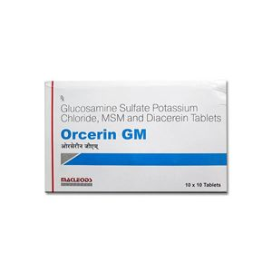
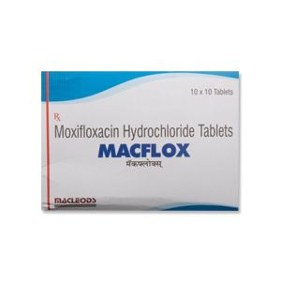
MEDICINE & USES
ORECERIN GM
● It is prescribed for treatment
of osteoarthritis.
MACFLOX
●Macflox Tablet is an antibiotic, used in the treatment of bacterial infections.

Slide 11
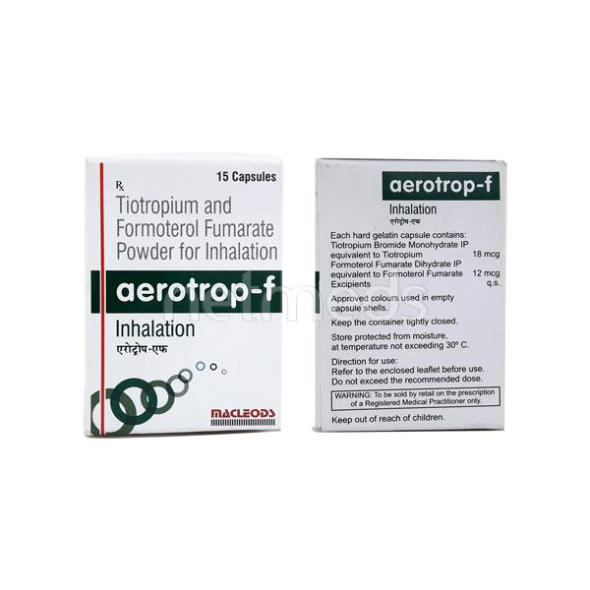
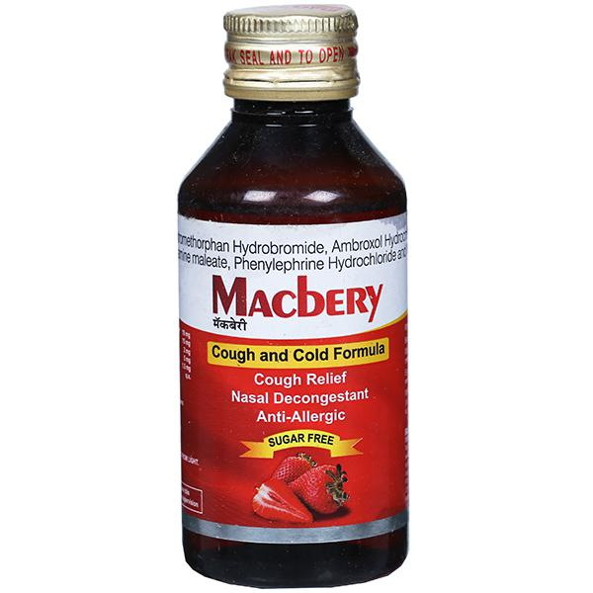
MEDICINE & USES
AEROTROP-f
●It is used in the treatment of chronic obstructive pulmonary disease and asthma.
MACBERY
●Macbery Syrup Strawberry Sugar Free is used in the treatment of cough.

Slide 12
Mission
To contribute towards improving patients quality of life across the globe, by providing effective and accessible medicines.

Slide 13
Vision
Our vision is to become a leading global pharmaceutical company by providing high quality, affordable and innovative therapeutic solutions for patients with diverse medical needs.

Slide 14
THANK YOU

