Slide 1
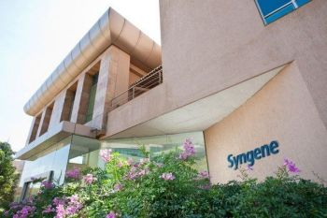
Shree M.&N. Virani science college (Autonomous)
An affiliated to saurashtra university
Department of Industrial chemistry
ITPR/Seminar Presentation
Syngene pharma ltd.
PREPARED BY : PARMAR VISHWARAJSINH R.
ENROLLMENT NO. : 19BIC033
DEPARTMENT : B.SC. INDUSTRIAL CHEMISTRY
(IV SEMESTER).
COLLEGE : SHREE M.&N. VIRANI SCI.
COLLEGE

Slide 2
DETAIL
The company was incorporated as syngene international private limited on November 18,1993 Bengaluru.
Syngene is an integrated research, development and manufacturing organisation providing scientific services.
They offer services in a wide range of industrial sectors, including biotechnology, nutrition, animal health, and pharmaceutical companies.

Slide 3
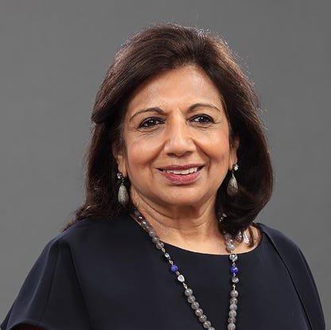
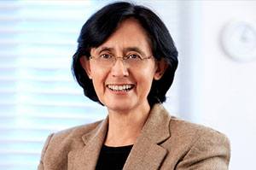
MANAGEMENT
Vinita Bali and Kiran Mazumdar Shaw are the CEO and DIRECTOR of SYNGENE PHARMA LTD.
VINITA BALI KIRAN MAZUMDAR SHAW
Jonathan hunt, paul blackburn, professor Catherine Rosenberg, Dr. Vijay kuchroo, carl decicco, kush parmar & sharmila karve.

Slide 4
MANUFACTURING
They offer clients a customized end-to-end solution to fulfil their R&D and manufacturing requirements.
Their Discovery Services are supported by advanced informatics capabilities that enable faster, more efficient decision making.
Syngene undertakes manufacturing of both small molecules and large molecules.
They have many type of reactors for particular reactions.

Slide 5
DEDICATED CENTERS
They have developed dedicated centers for particular other pharma companies to fulfill their requirements about Research and development.
1. Biocon Bristol Myers Squibb Research & Development Center (BBRC)
2. Baxter Global Research Center (BGRC)
3. Syngene Amgen Research And Development Center (SARC)
4. Herbalife Nutrition R&D Center (HNRD)

Slide 6
SMALL MOLECULE DRUG
A drug that can enter cells easily because it has a low molecular weight. Once inside the cells it called small molecule drug.it can affect other molecules, such as proteins, and may cause cancer cells to die.
Small molecules make up 90% of pharmaceutical drugs.
Examples :
1. Insulin- To control blood sugar.
2. Aspirin- To reduce fever and relieve mild to moderate pain.
3. Antihistamines- To relieve symptoms of allergies.

Slide 7
LARGE MOLECULE DRUG
Large molecules (biologics), also called biopharmaceuticals, are a type of drugs. These are based on proteins which have a therapeutic effect.
Examples :
1. Victoza — its an injectable medicine used to help lower blood sugar
in adults.
2. Rebif — it helps the body fight viral infections.
3. Levemir — Levemir is a prescription medicine used to treat the symptoms of . Type I or II Diabetes Mellitus.

Slide 8
SYNGENE’S EFFORTS TO FIGHT AGAINST COVID-19
Syngene is a voluntary license holder from Gilead for manufacture and sale of Remdesivir for COVID-19 patients.
From April 21, 2021 to June 6, 2021, Syngene has manufactured and supplied 1,29,755 Remdesivir lyophilised injections to the State of Maharashtra through its distribution partners .

Slide 9
FINANCIAL REPORT
Here is a summary of financial information of SYNGENE INTERNATIONAL LIMITED for the financial year ending on 31 March, 2021.
Revenue / turnover of SYNGENE INTERNATIONAL LIMITED is Over INR 500 cr.
Current share price of syngene pharma is 599 ₹.
Net worth of the company has increased by 10.52 %.
EBITDA of the company has increased by 15.14 %.
Total assets of the company has increased by 12.42 %.
Liabilities of the company has increased by 36.45 %.

