Slide 1
SHREE M. &N VIRANI SCIENCE COLLAGE, (AUTONOMOUS) An affiliated to saurashtra university department of industrial chemistry
ITPR/Seminar Presentation
Coral Laboratories Ltd.
Prepared by:
Dudhatara yash k.
19BIC011
Semester-v

Slide 7
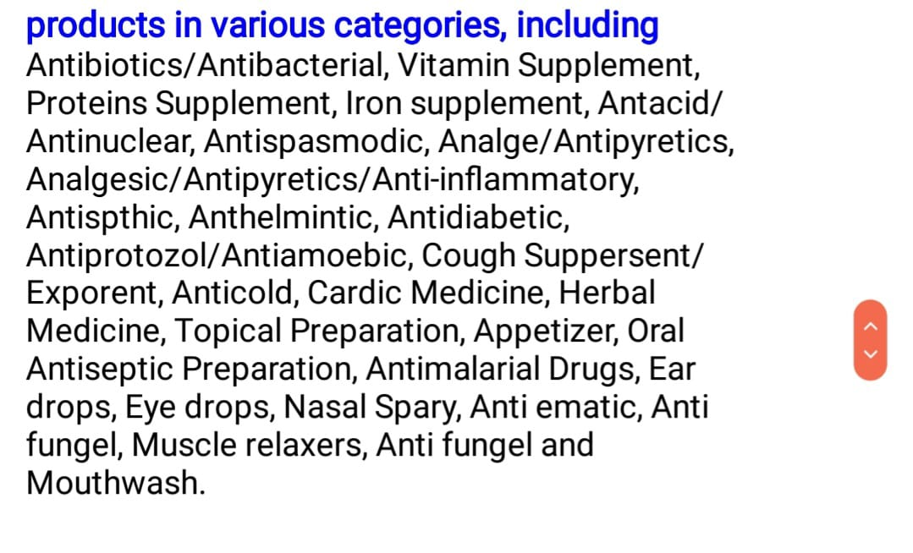

Slide 9
