Slide 1
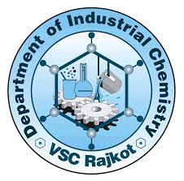
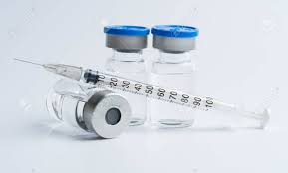
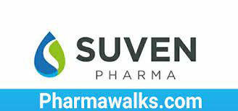
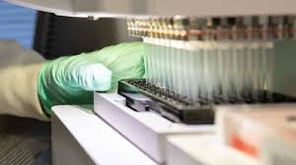
SHREE M&N VIRANI SCIENCE COLLEGE (AUTONOMOUS) ITPR SEMINAR
Prepared By : Dobariya Ravi H
EN :19BIC010
Program : B.Sc Industrial chemistry
Sem : V
Seminar : Pharma industry
Company : Suven life science ltd.

Slide 2
OUTLINE
 WHAT IS PHARMACEUTICAL INDUSTRY ?
 INTRODUCTION
 COMPANY : SUVEN LIFE SCIENCE LTD
 MEDICINE AND USES
 VISION
 MISSION
 BUSINESS STRUCTURE
 Facility Capacities Overview
 INSRUMENT IN MICROBIOLIGY LAB

Slide 3
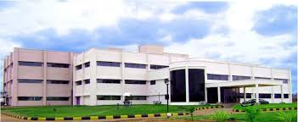
WHAT IS PHARMACEUTICAL INDUSTRY ?
❑ The pharmaceutical industry discovers, develops, produces, and markets drugs or pharmaceutical drugs for use as medications to be administered to patients, with the aim to cure them, vaccinate them, or alleviate the symptoms.
❑ Pharmaceutical companies may deal in generic or brand medications and medical devices.

Slide 4
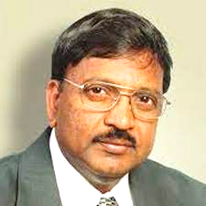
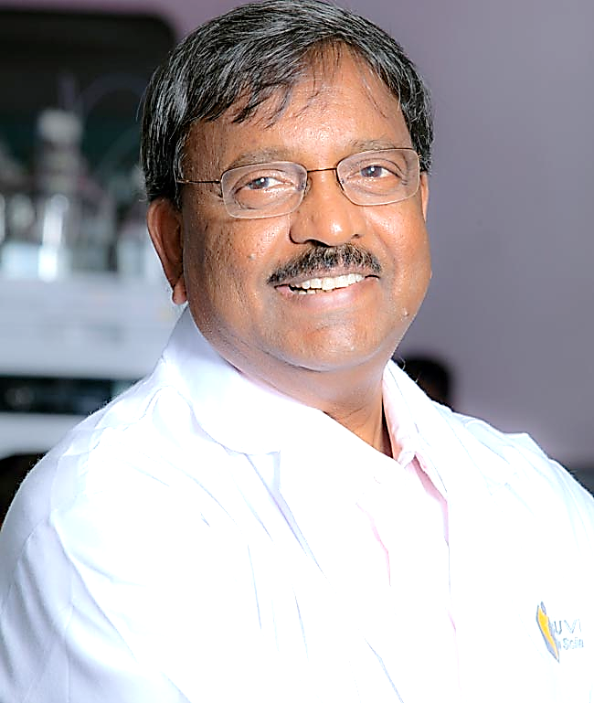
INTRODUCTION
Incorporated in Mar. '89 as a private limited company Suven Pharmaceuticals (SPL) was converted into a public limited company in Jan. '95.
It was promoted by Sudharani Jasti and Venkateswarlu Jasti who is the present Chairman & CEO of the company.
Suven life sciences was promoted by Mrs.and ms. Venkat jasti in 1989 , as a private limited company.
Venkateswarlu Jasti
CEO of Compony&Chairman and managing director

Slide 5
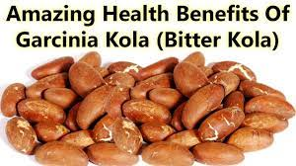
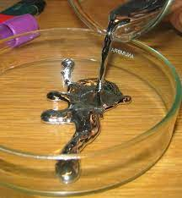
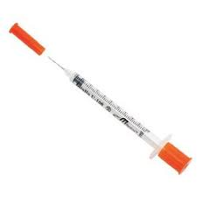
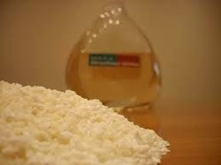
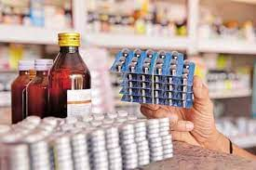
company :suven life sciences ltd.
Mercury.
Cleaning Machine.
Bitter Kola.
Insulin syringe.
Activatiom powder.
Oral liquids

Slide 6
Medicin and uses
masupirdine (suvn-502)
SUVN-502 is a novel, potent, safe, highly selective and orally active antagonist at a central nervous system serotonin receptor site 5-HT6 intended for treatment of cognitive disorders such as Alzheimer's and Schizophrenia, an unmet medical need.
C21H24BrN3O3S

Slide 7
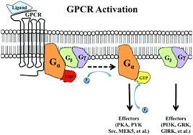
What does suven life scince do ?
Suven life science is a biopharmaceutical company
on discovering,developing and commercialining novel
pharmaceutical products, which are first in class or
Best in class therapies through the use of GPCR
(g protein-coupled receptors) targets.
Gpcr is also called seven-transmembrane receptor

Slide 8
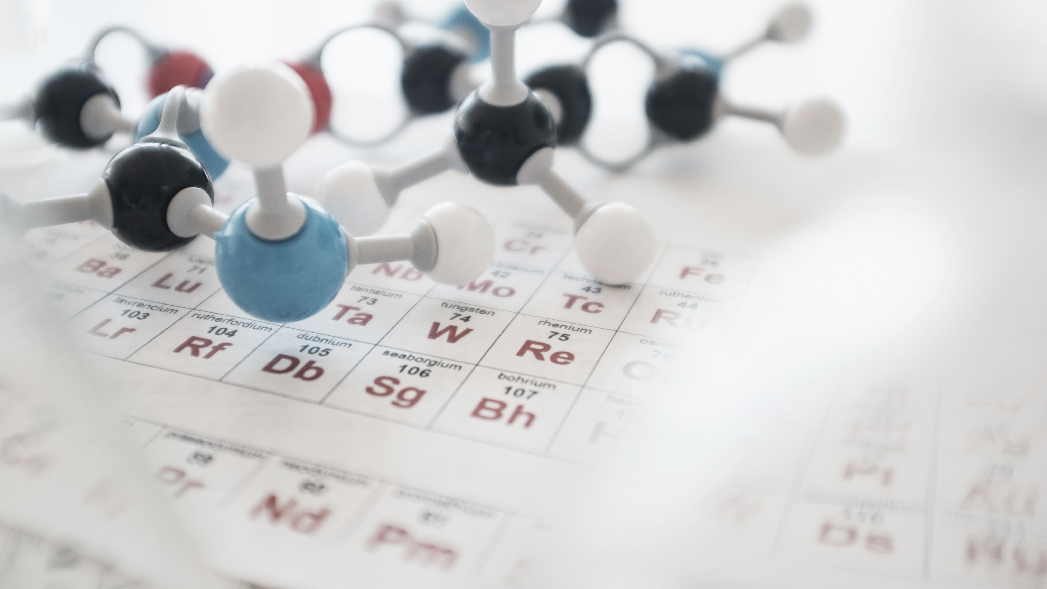
Vision
To Emerge as a leadng player by providing full spectrum
services in drug development, manufacturing and support
under collaboration with leading global life science
players.

Slide 9
Mission
Become a leading company focused on treatments for unmet medical needs in mental health
Health for patients and value for partners
In search of new CNS therapies

Slide 10
BUSINESS STRUCTURE
In operation since 1989 to 2003 as SUVEN PHARMACEUTICAL LTD.
Transformed to SUVEN LIFE SCIENCES LTS From 2003 to 2019
Demerged from suven life science and in operation as suven pharmaceutical Limited since January,2020
Strong asset base and financial fundamentals
Pioneering efforts in C-R-A-M-S since 1994
Relationship with many Global Life science majors
IPO in 1995 –Listed on NSE and BSE
More than 400+ scientific professionals inclides 40+ ph.D holders.

Slide 11
30 years of Pharmaceutical Relationship
FORMULATION
Pharmaceutical product development
Product scale up and manufacturing service
Pharmaceutical Analytical services
Regulatory management services

Slide 12
Facility Capacities Overview
- 110,000+ sq. ft of World-class Infrastructure comprising
cGMP Scale-up
Manufacturing and Packing of Exhibit, Commercial and Clinical Supply Batches
Warehouse
Analytical Method Development & Validation Laboratories
Dissolution Testing Laboratory
Wet Chemistry Laboratory
Microbiology Testing Laboratory
Stability Chambers (220,000 L)
Formulation Development Laboratories
Process Development Laboratories
Packaging Development and Testing Laboratories

Slide 13
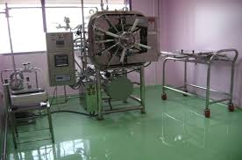
Instrument in microbiology lab
MICROBIOLOGY LABORATORY INSTRUMEN
Horizontal Laminar Air Flow Benches (2No's)
Incubators (2000 liters)
Cooling Incubator 2-8 °C (400 liters)
Autoclave
Colony Counter
Carl Zeisis Microscope

